Slide 1

Capstone Project On
“TRAVEL APPROVAL APP”
BY:
Name :SAKAM SWETHA
Batch WIP-SF-13
LMS Id: MGSA_538

Slide 2
CONTENTS
INTRODUCTION TO SALESFORCE
INTRODUCTION OF TRAVEL APPROVAL APP
MODULE 1
MODULE 2
MODULE 3

Slide 3

INTRODUCTION TO SALESFORCE
Salesforce is a cloud-based software company that provides its customers with a platform to develop their own applications.
The software or application once created can be uploaded onto the cloud allowing the end-users to view them.
Salesforce is currently providing various software solutions and platforms for developers to create and distribute custom software/applications.

Slide 4

INTRODUCTION OF TRAVEL APPROVAL APP
The travel approval project in Salesforce is a system designed to automate and streamline the process of requesting and approving travel expenses for employees.
The project involves several components, including a custom object to track travel requests, a custom approval process, and various integrations with external systems.
Overall, the travel approval project in Salesforce provides a streamlined and efficient way for employees to request and manage travel expenses, while also providing managers with the tools they need to ensure that all expenses are approved and accounted for.

Slide 5

Module -1
This project module focuses on the non-coding approach to modifying the user interface, as you customize an app that tracks company travel.
Create Custom App, Objects, Fields & Relationships, and how you customize the App using declarative tools.

Slide 6
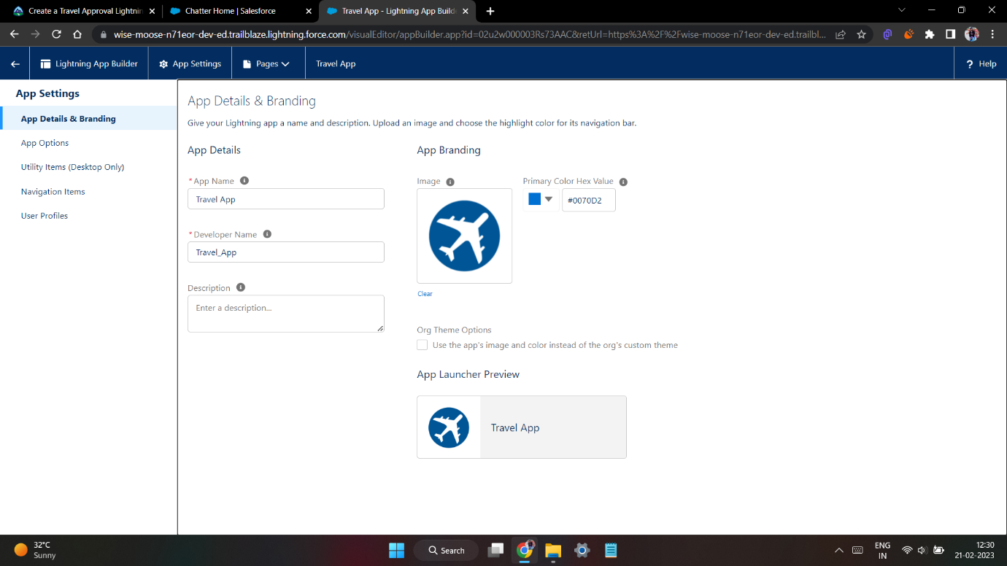
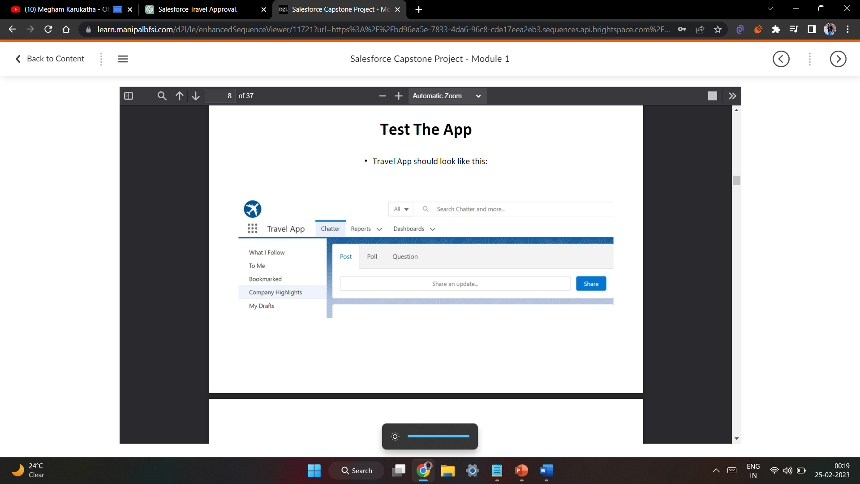
Exercise-01 Creating Lightning App: TRAVEL APP

Slide 7
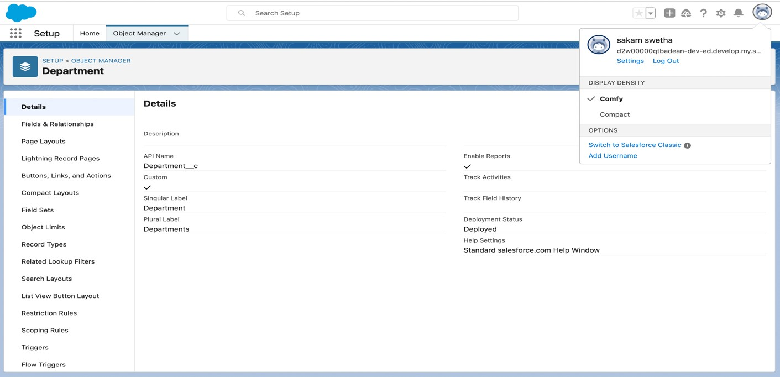
Custom object Department and Creating custom fields in Department object

Slide 8
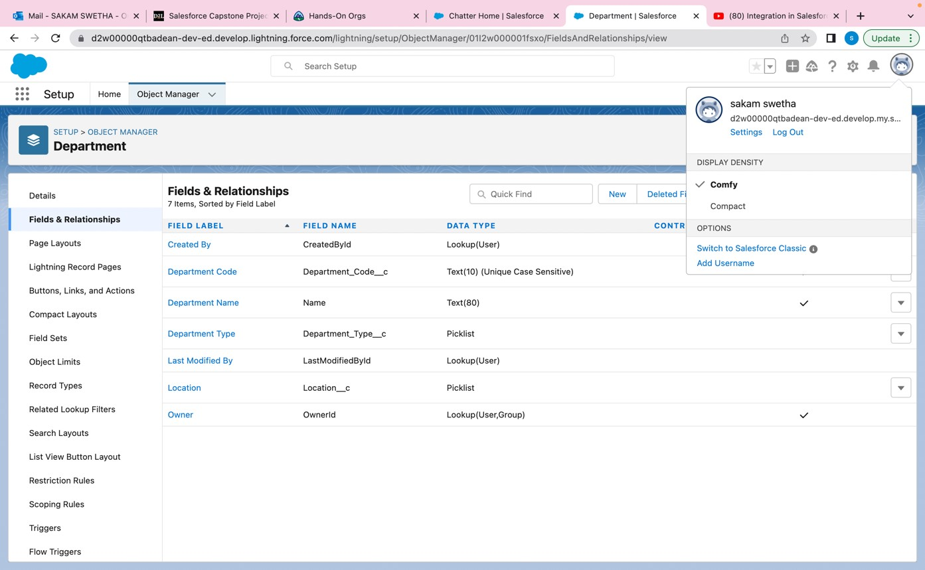
Field dependency in department

Slide 9
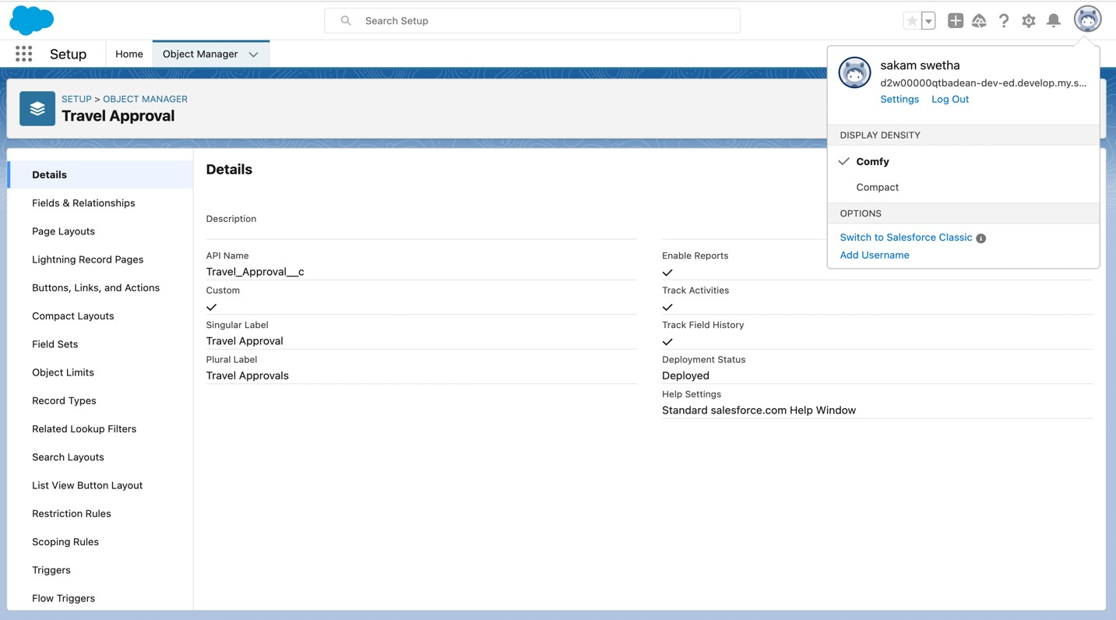
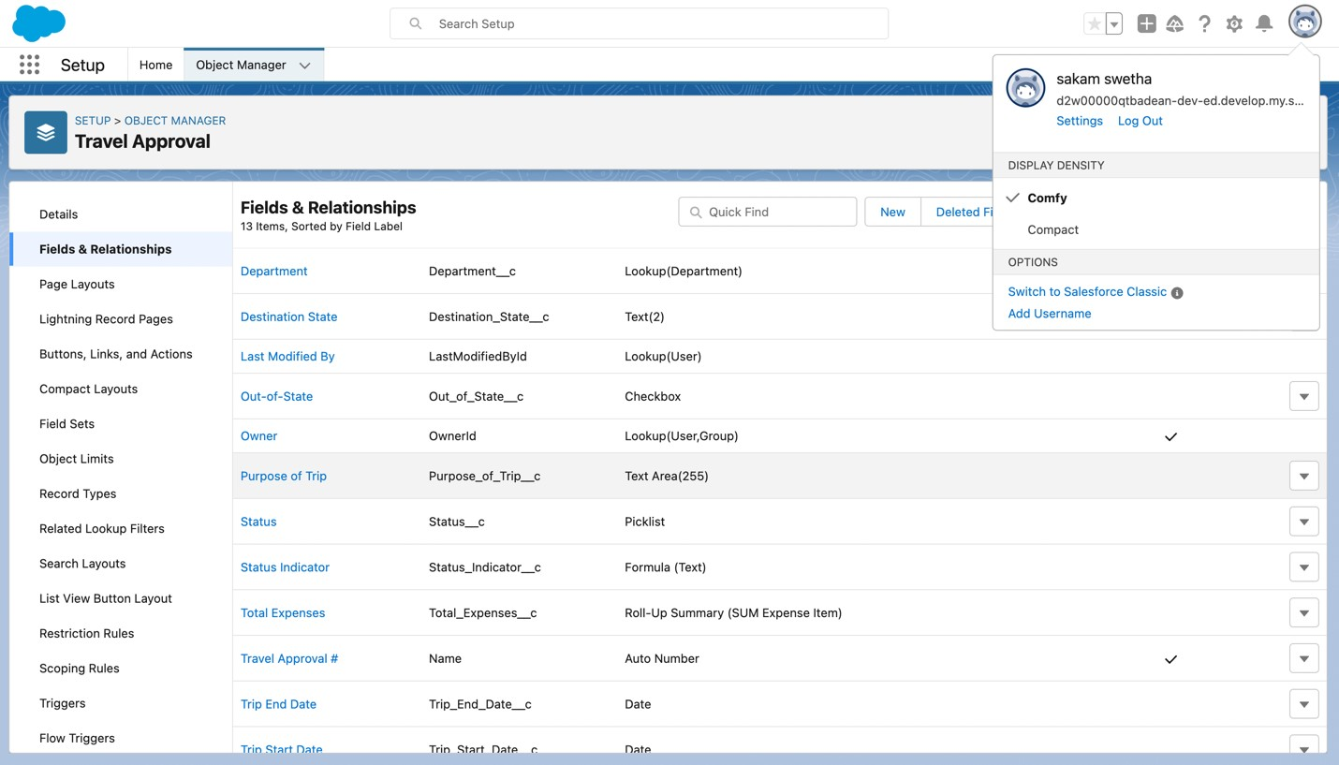
Creating Custom Object Travel Approval and Custom Fields in that Object

Slide 10
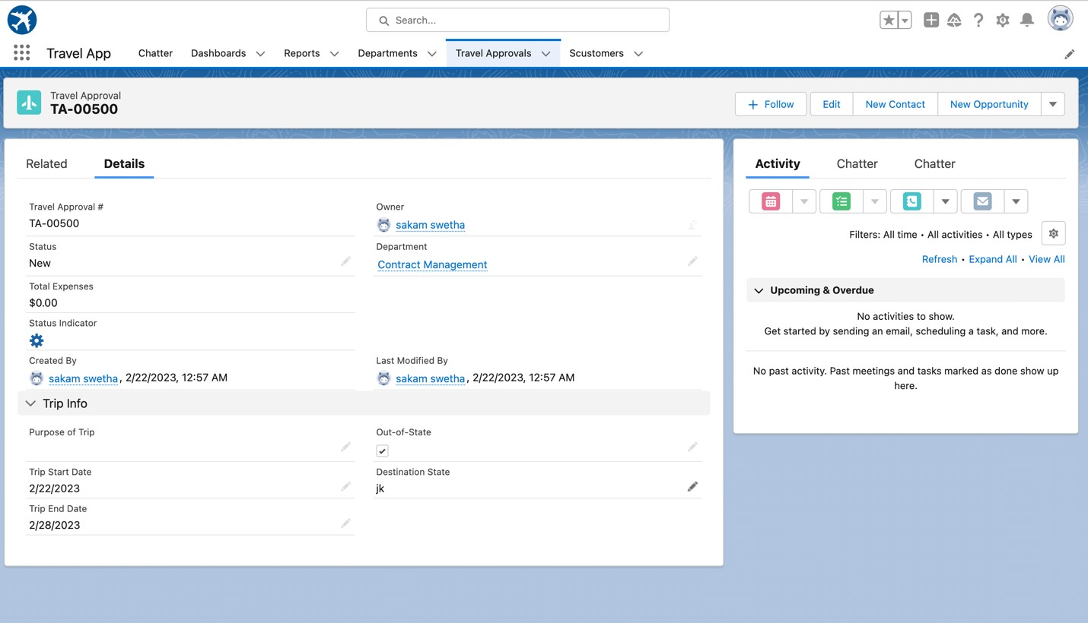
After creating travel approval object with fields, it looks as shown below

Slide 11
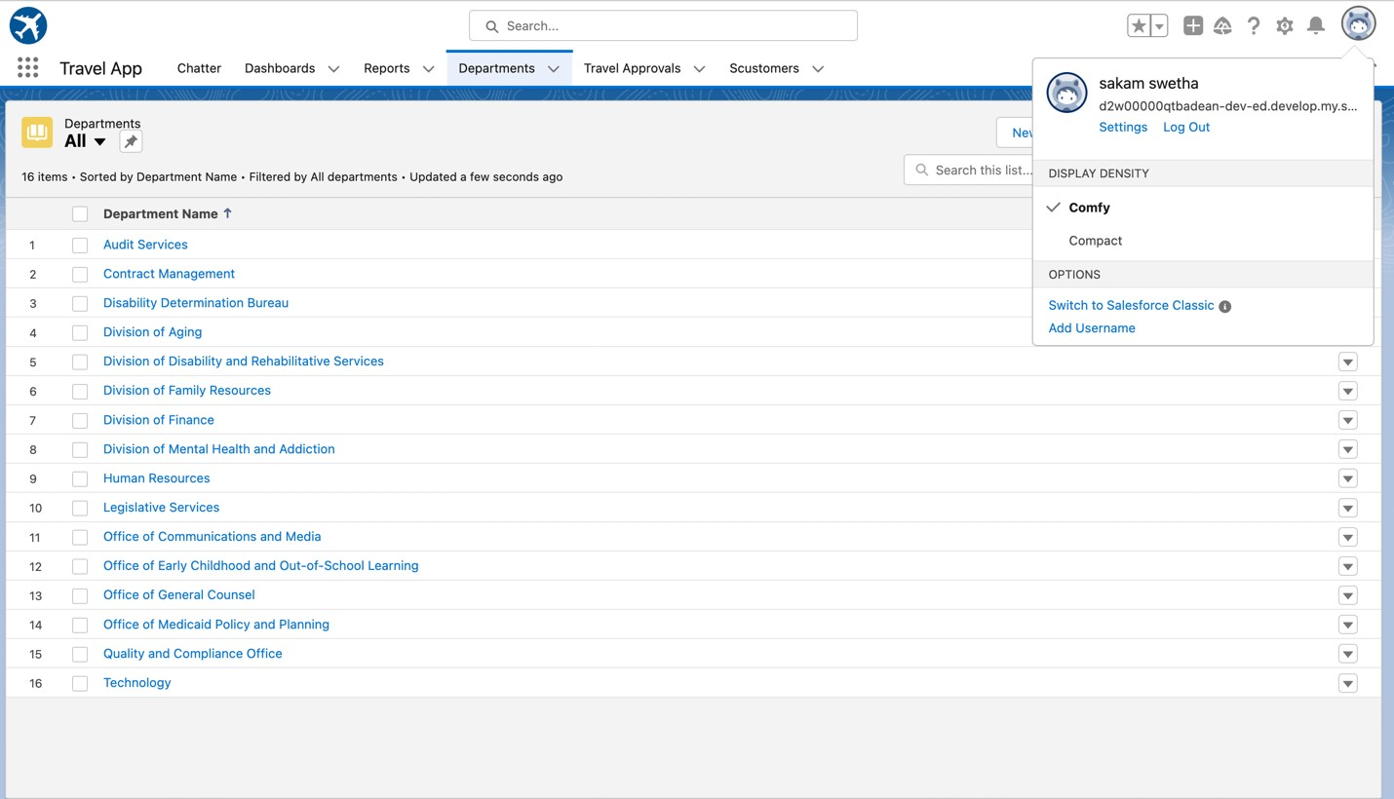
Importing Department records using data import wizard and imported record data status can viewed below

Slide 12
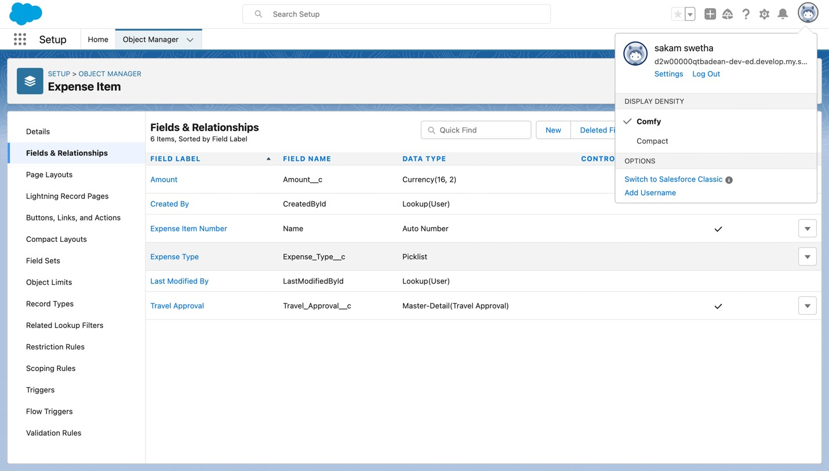
Exercise-02 Creating Expense Item custom object and Custom fields in Expense Item object

Slide 13
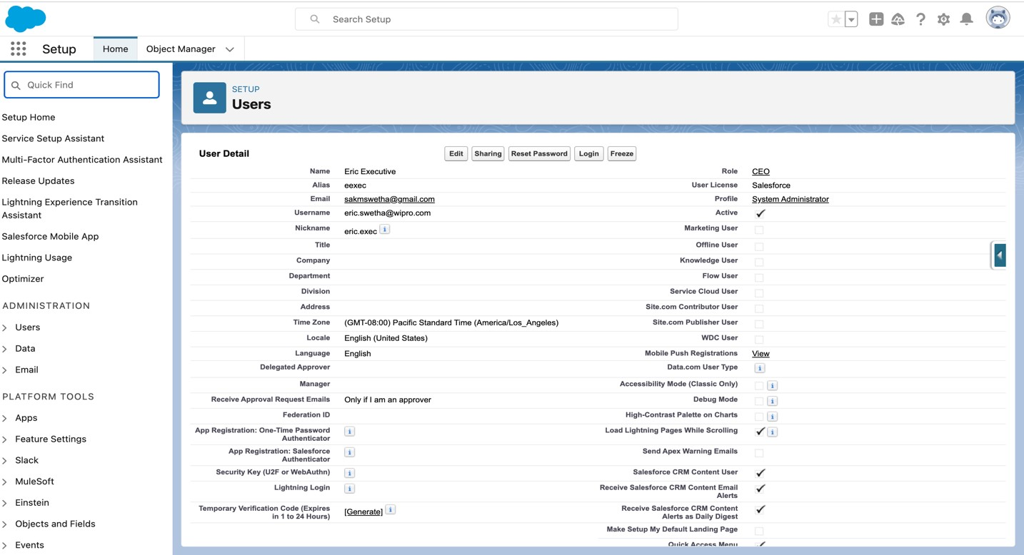
Creating User Eric

Slide 14
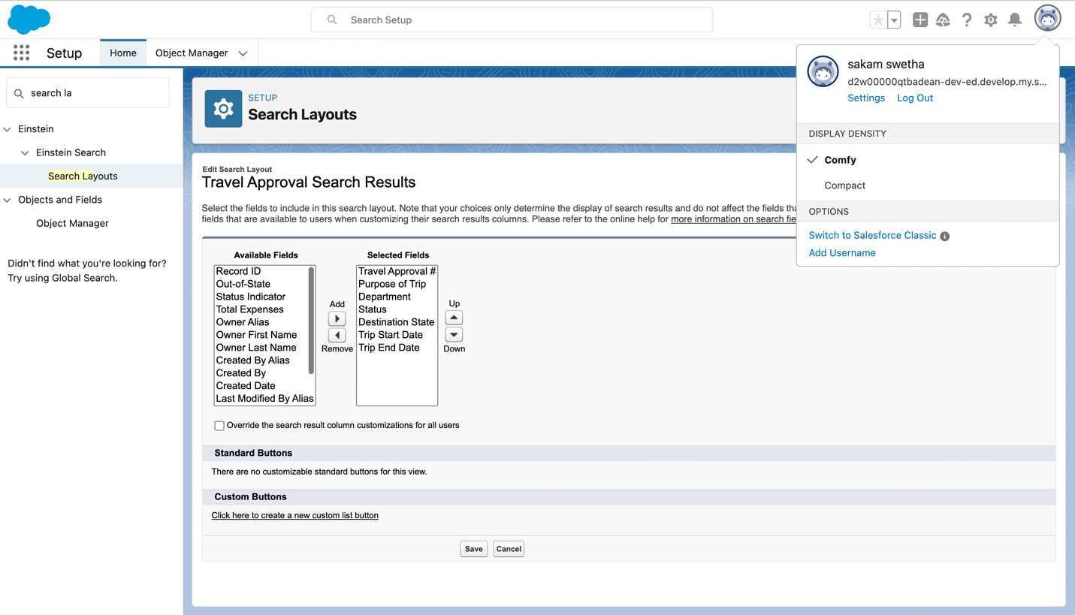
Customize The Travel Approval Default Search Layout

Slide 15
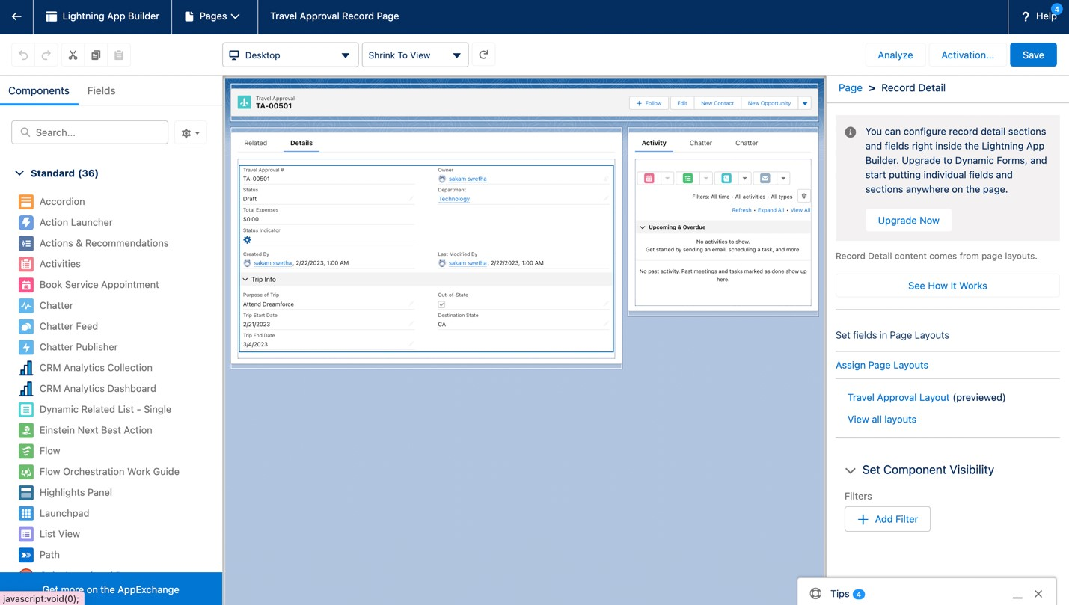
Customizing page layout

Slide 16
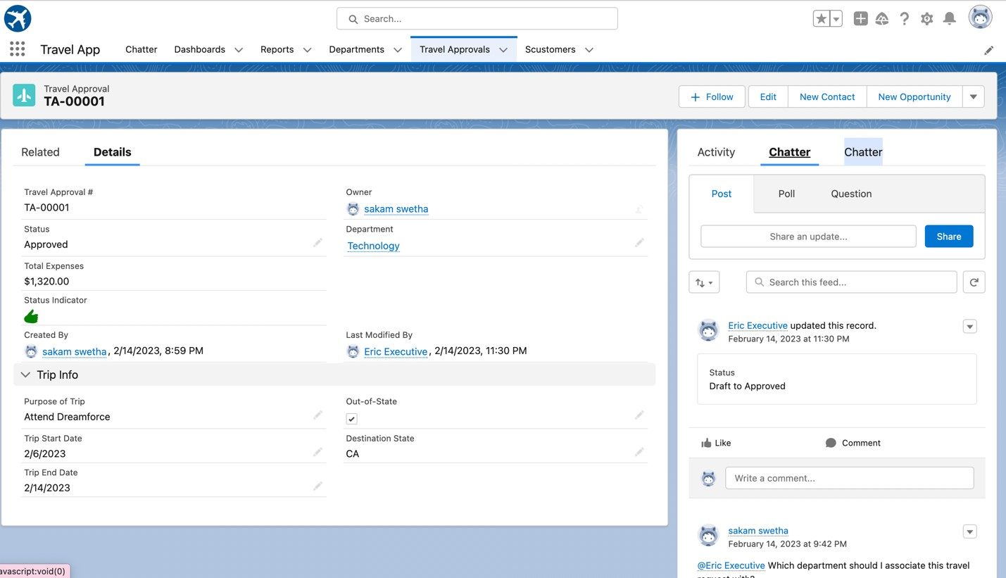
Test the app:

Slide 17

MODULE 2
This project module focuses on the Automation and Analytics Tools to enhance your custom App development.
Define Business logic using Validation rules, Roll-up summary fields, Formulas, Flows & how you track Travel Approvals using Reports and Dashboards.

Slide 18
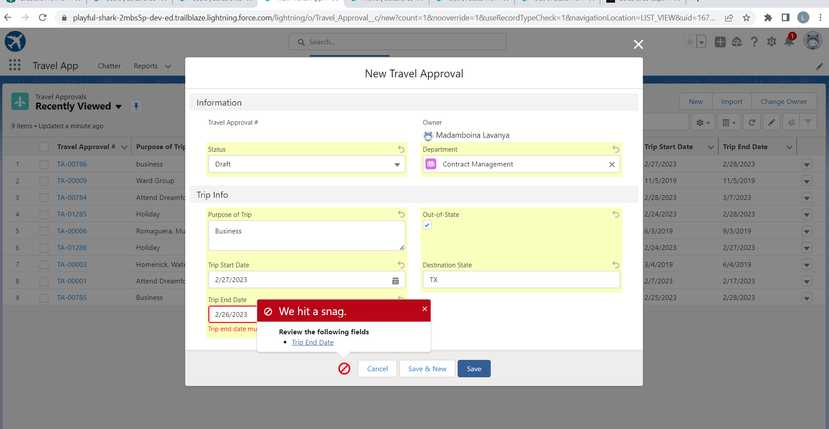
Validation Rule that trip end date always >= start date

Slide 19
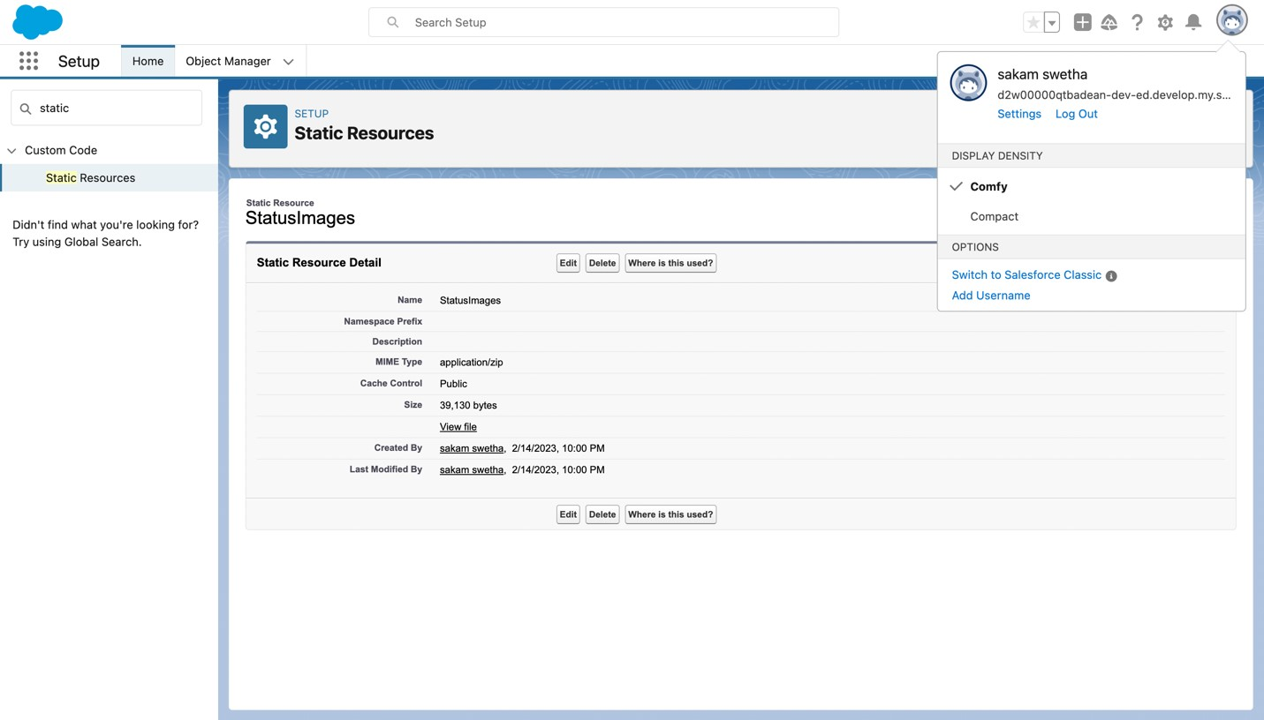
Creating Formula Fields Static Resource with name StatusImages

Slide 20
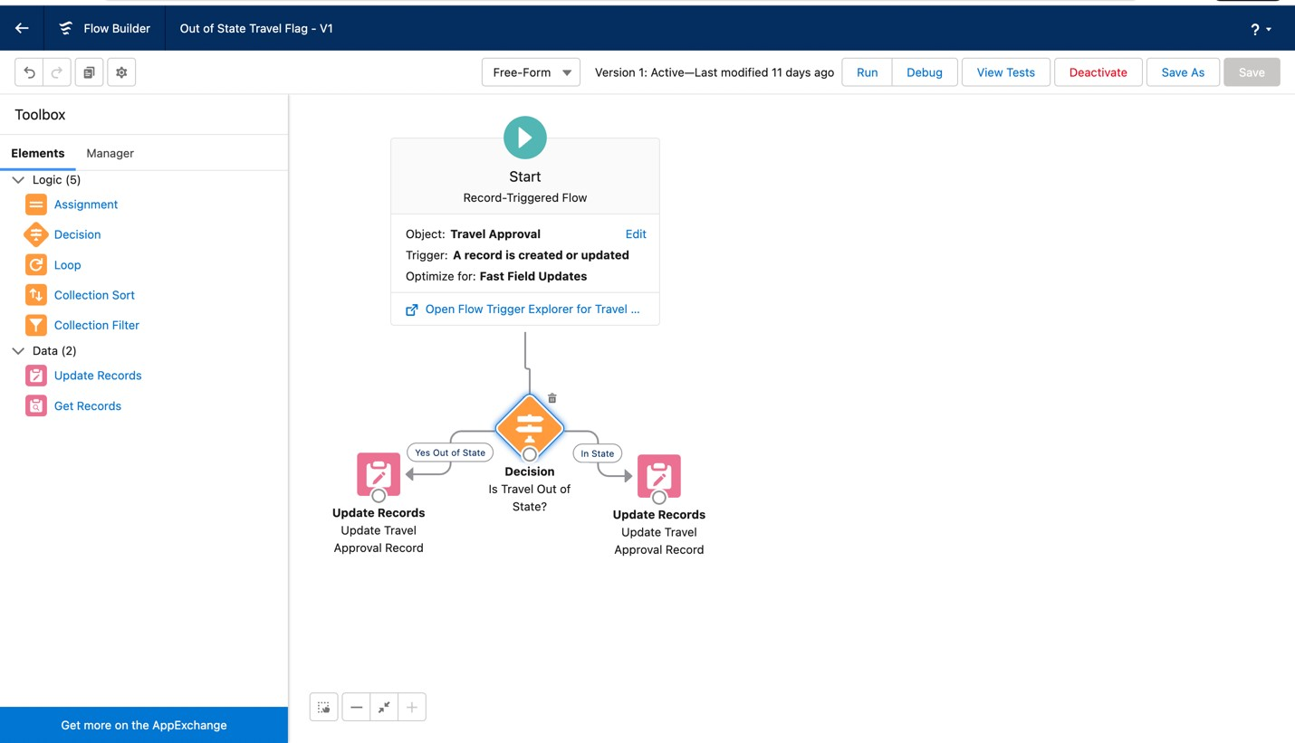
Create a flow looks as shown, save and activate

Slide 21
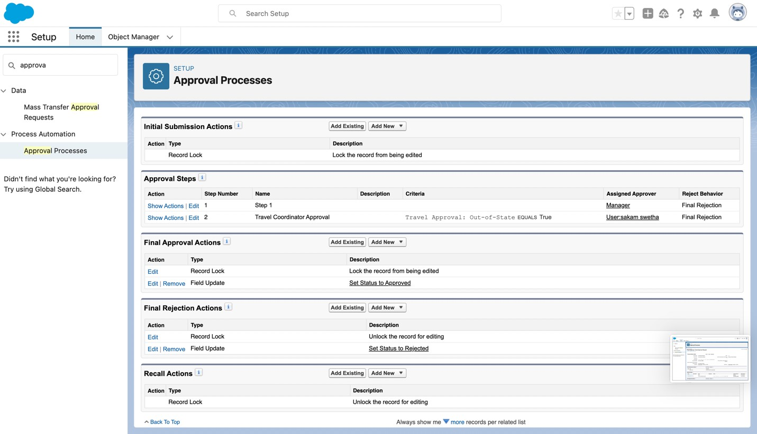
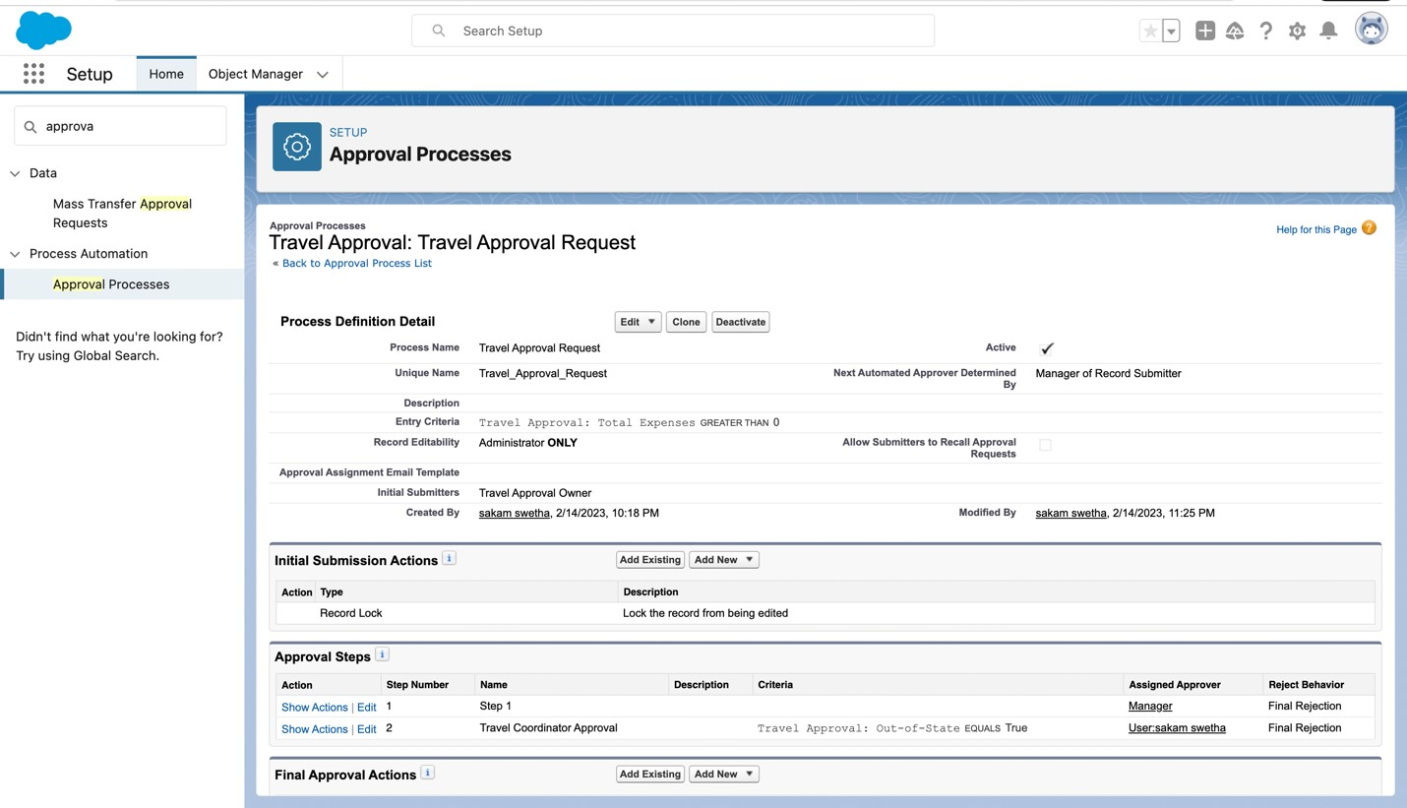
Creating an Approval Process to send travel approvals to manager or travel coordinator

Slide 22
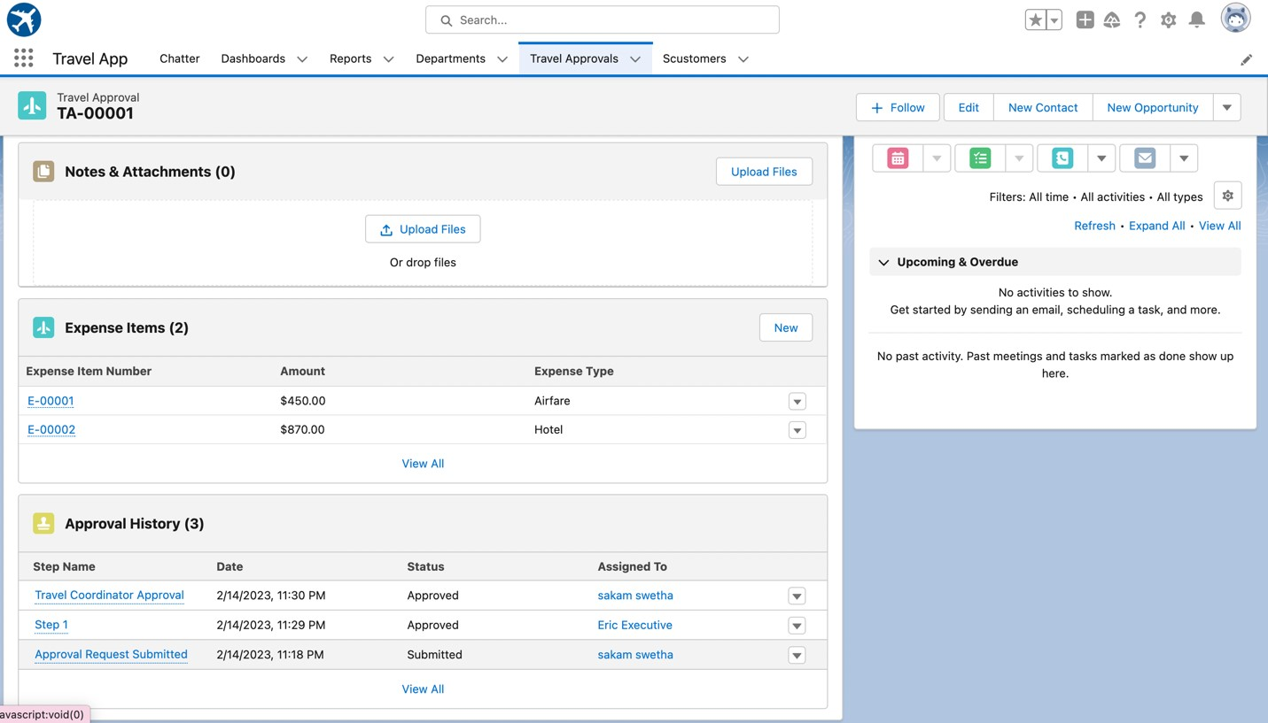
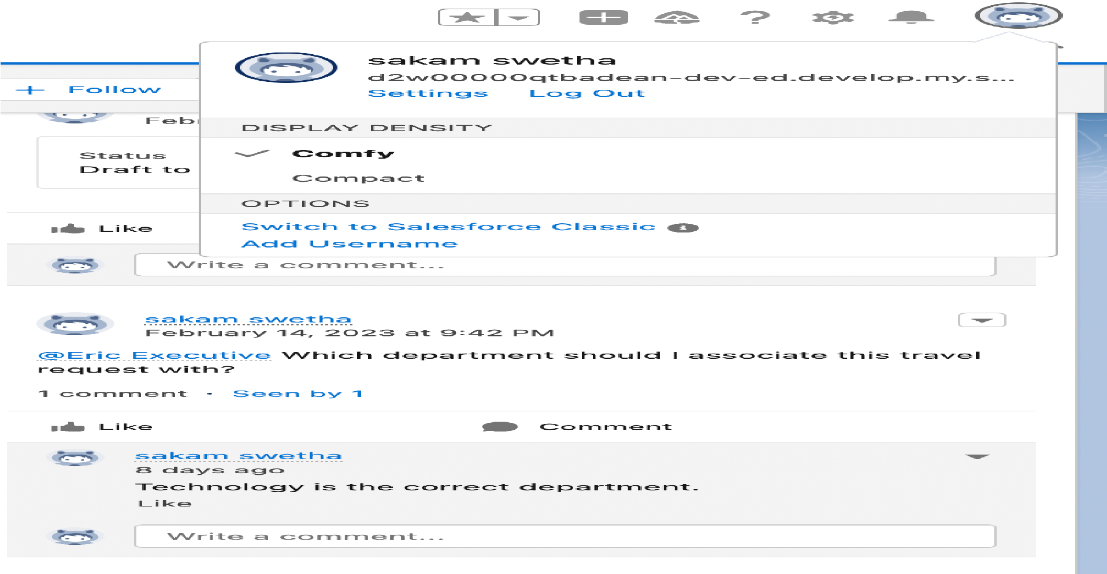
Testing the Approval Process Status is Pending Here, Next Submit For Approval

Slide 23
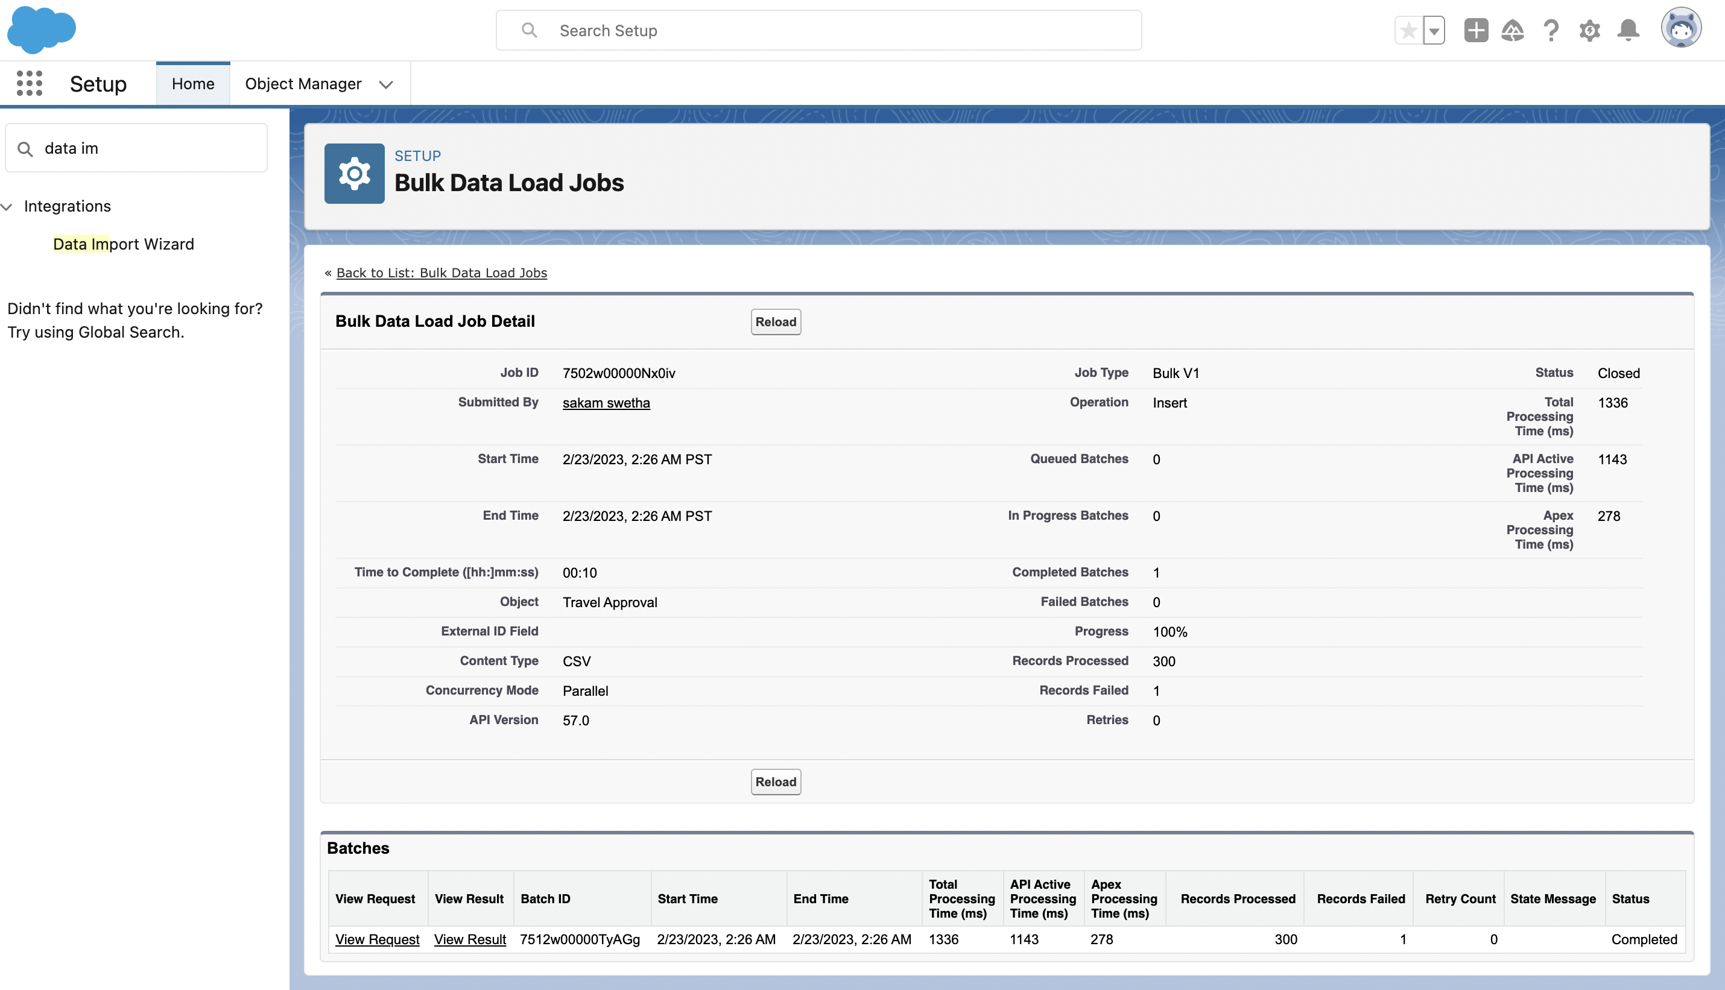
Using Data import wizard to import travel approval records , later the Records imported successfully

Slide 24
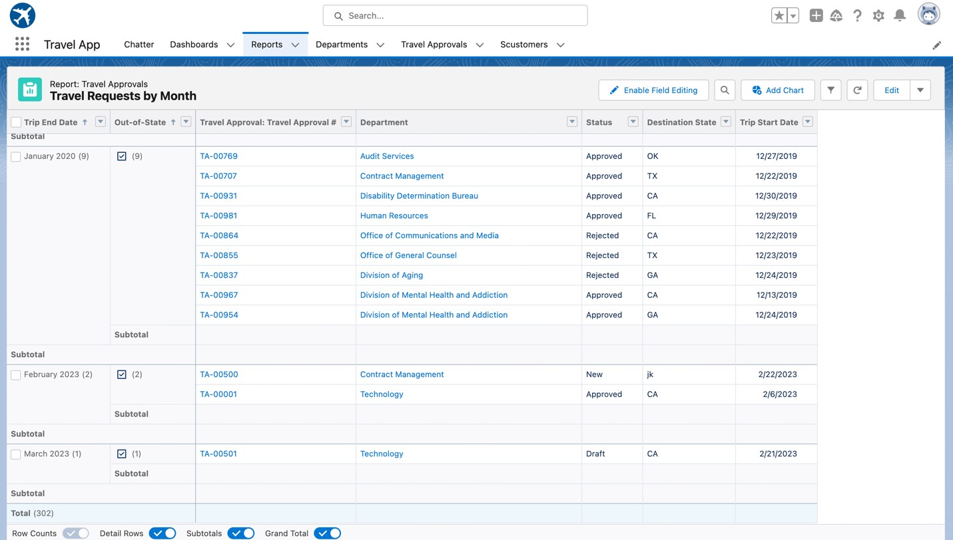
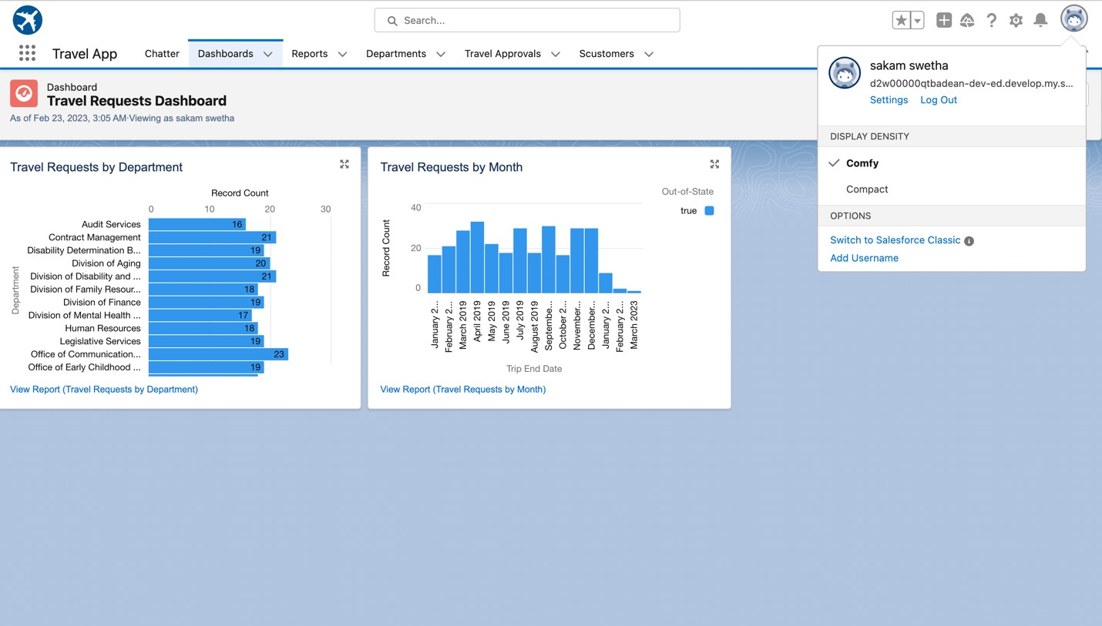
Created Reports and Dashboard

Slide 25

MODULE 3
This project module focuses on the coding approach to extend the functional capabilities of your custom App.

Slide 26
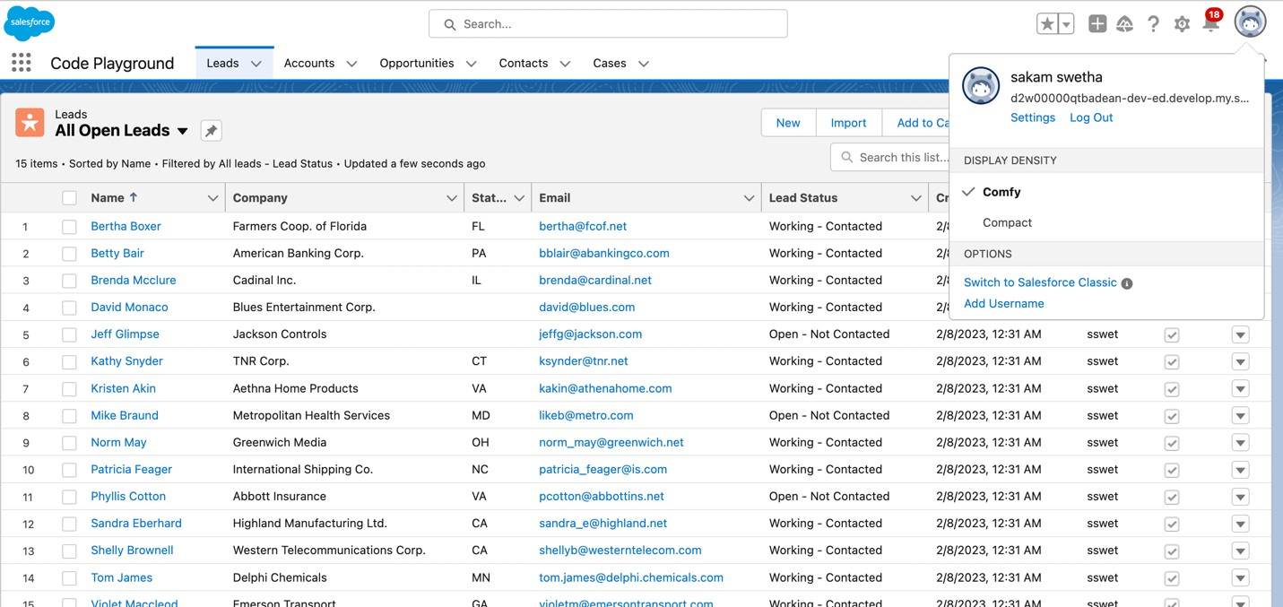
Exercise - 01 Creating Code Playground Lightning App with Lead, Account, Contact, Opportunity, Case to navigation profile as system admin.

Slide 27
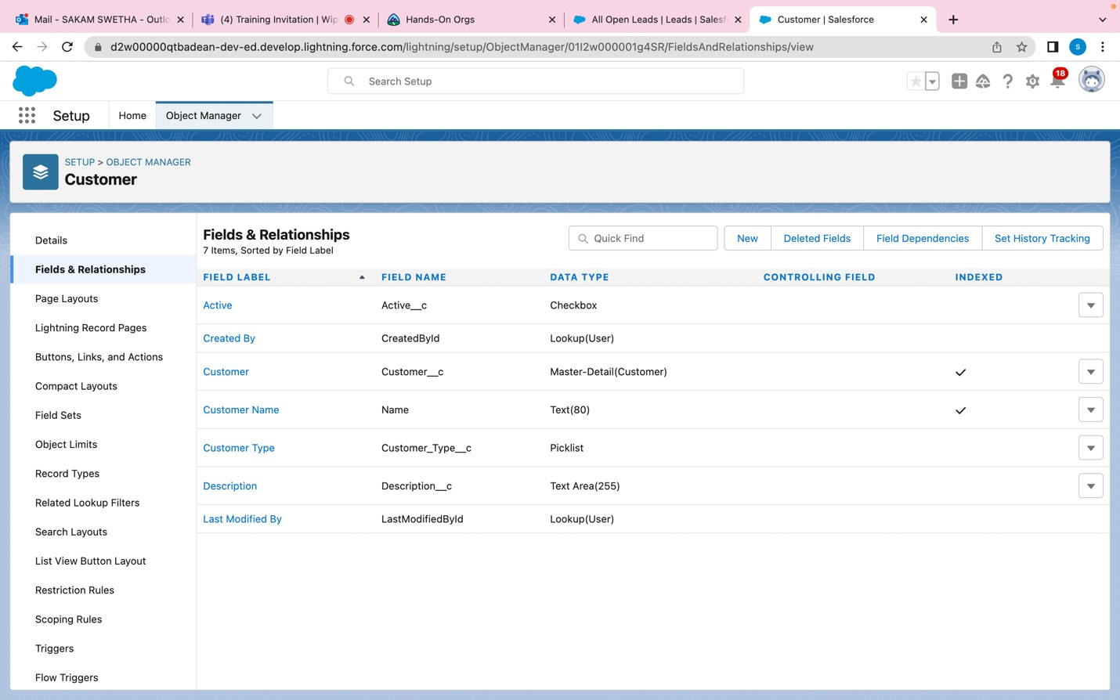
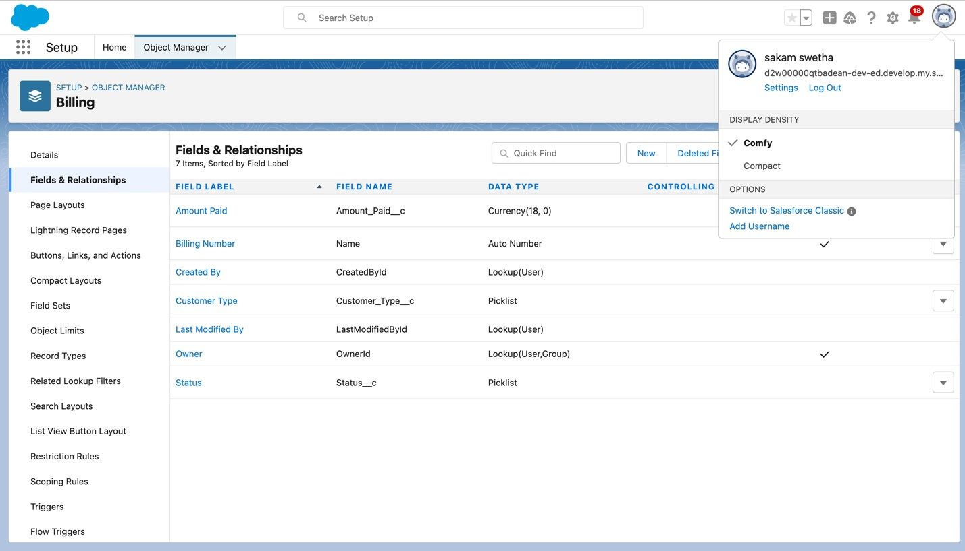
Creating custom objects Customer , Billing and add related fields

Slide 28
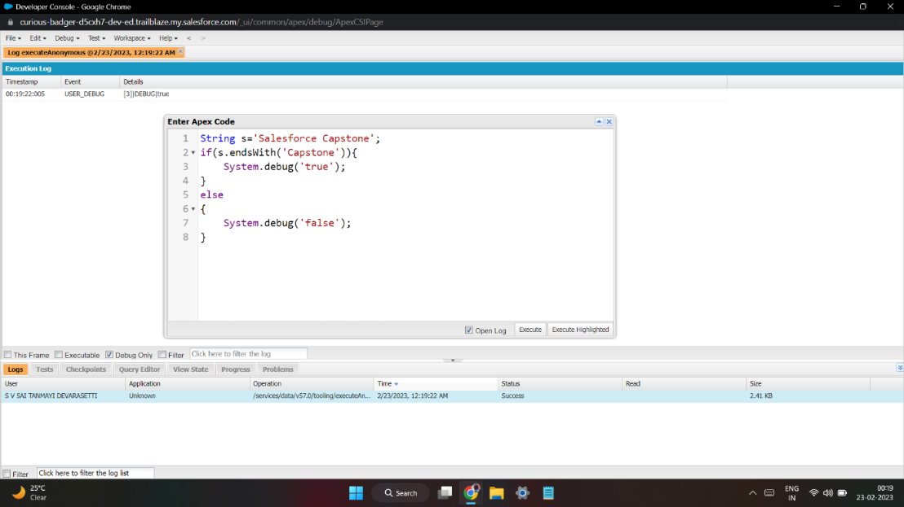
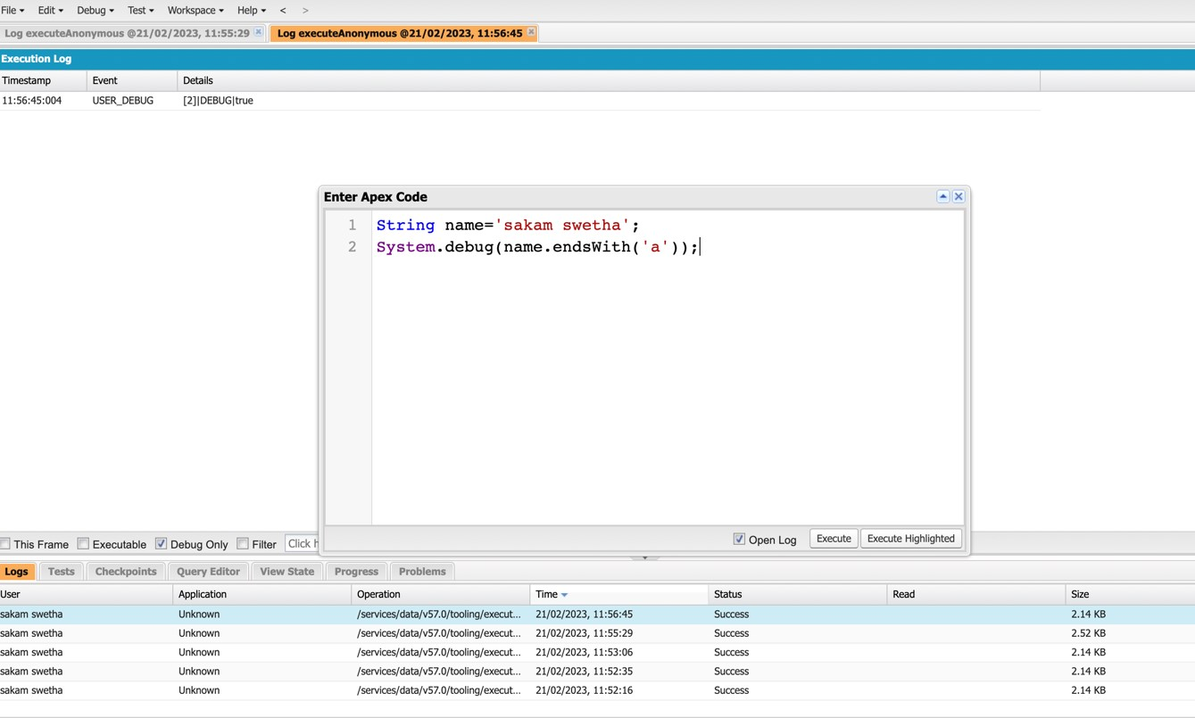
Exercise - 02 Define a String Variable & use string method ‘endsWith’ to display the output.

Slide 29
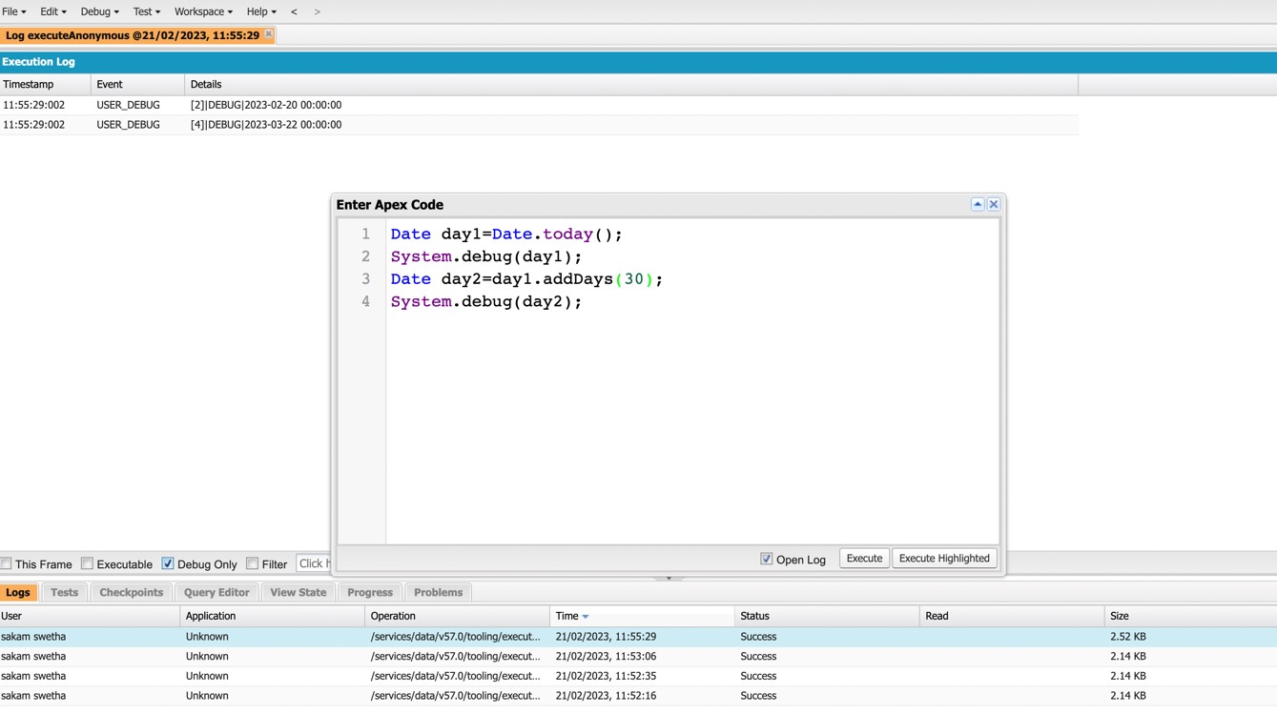
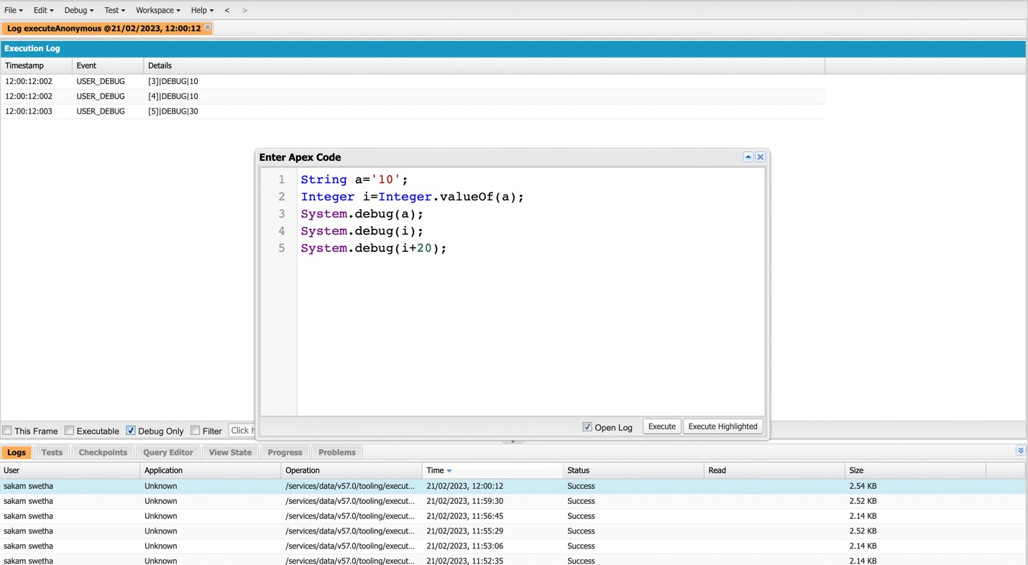
2. Define 2 Date type variables, use Date method today() & addDays(30) to display the output
3. Display the Output of an integer variable from string ‘10’ and then add 20 to it.

Slide 30
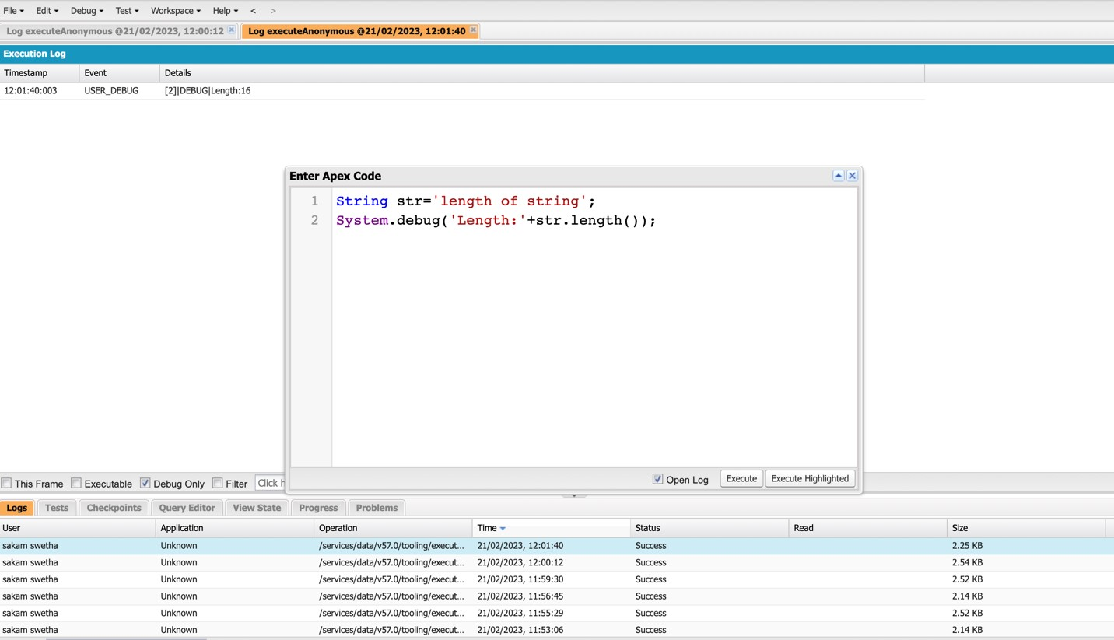
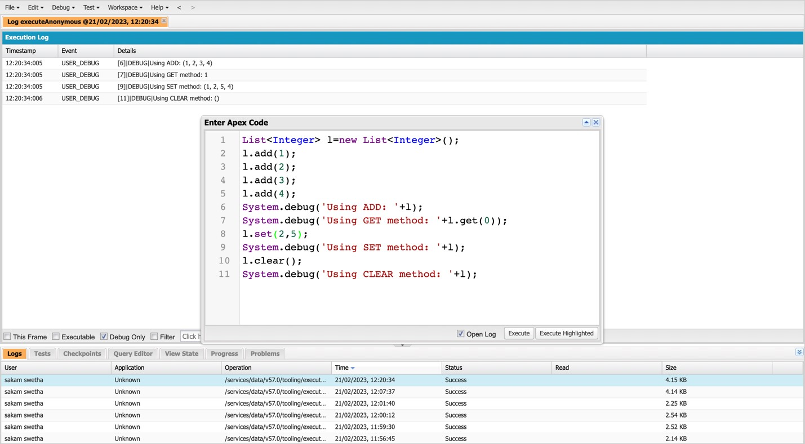
4.Define a string variable & Use String method length() to Display the output
5.Define a list of integer and display the output using add(), get(), set() , clear() , Methods

Slide 31
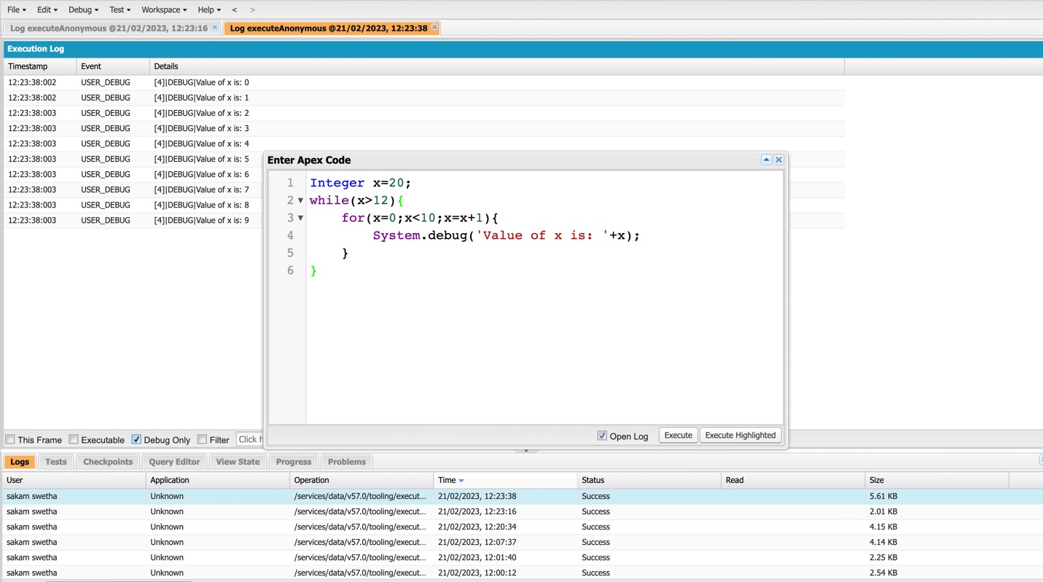
6. Use Execute Anonymous to define and execute the following code to display the value of x = 0 to 9.

Slide 32
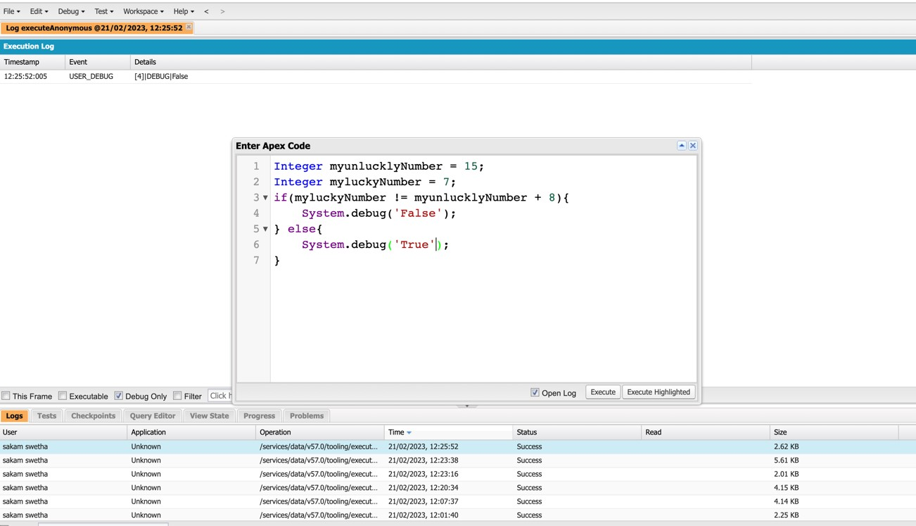
Exercise -03 Answer the following in True or False: Integer myunlucklyNumber = 7; Integer myluckyNumber = 15; myluckyNumber != myunlucklyNumber + 8.

Slide 33
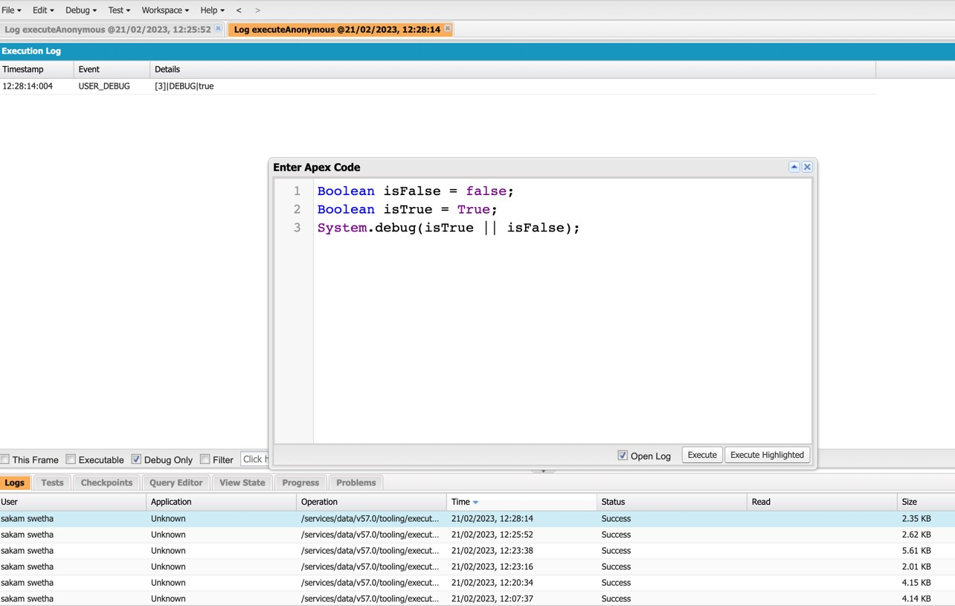
Exercise-04 Answer the following in True Or False: Boolean isFalse = false; Boolean isTrue = true;

Slide 34
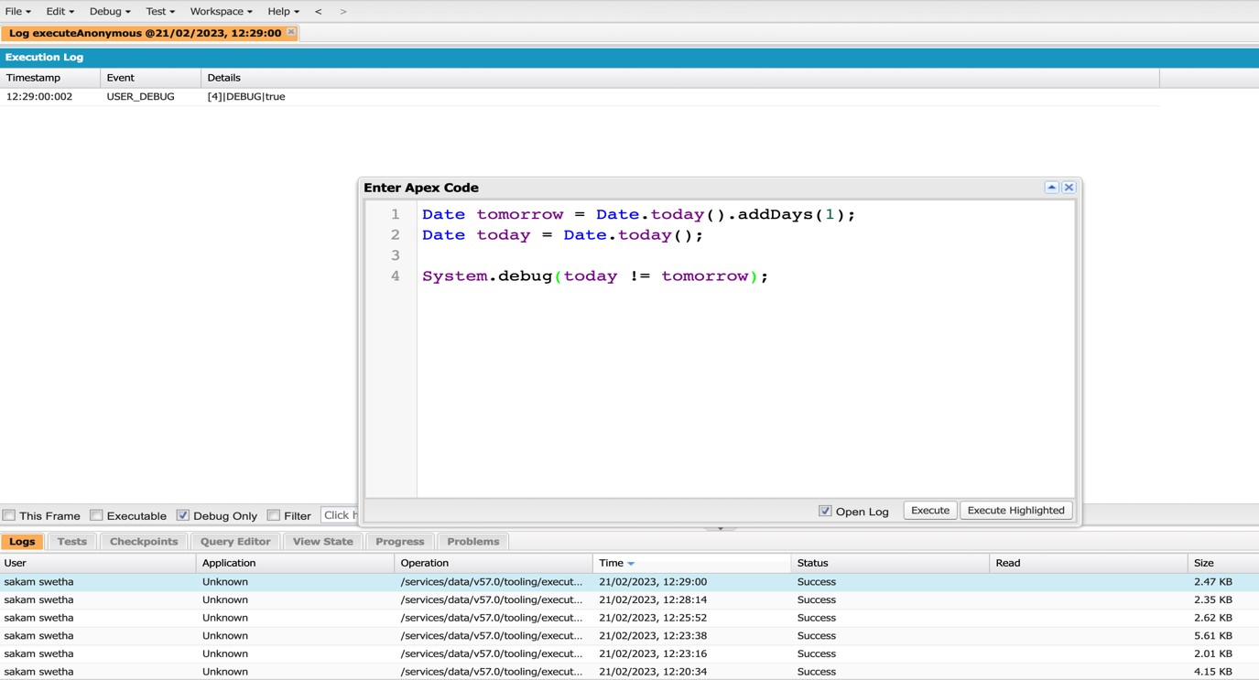
Exercise -05 Answer the following in True Or False: Date tomorrow = Date.today().addDays(1); Date today = Date.today(); today != tomorrow

Slide 35
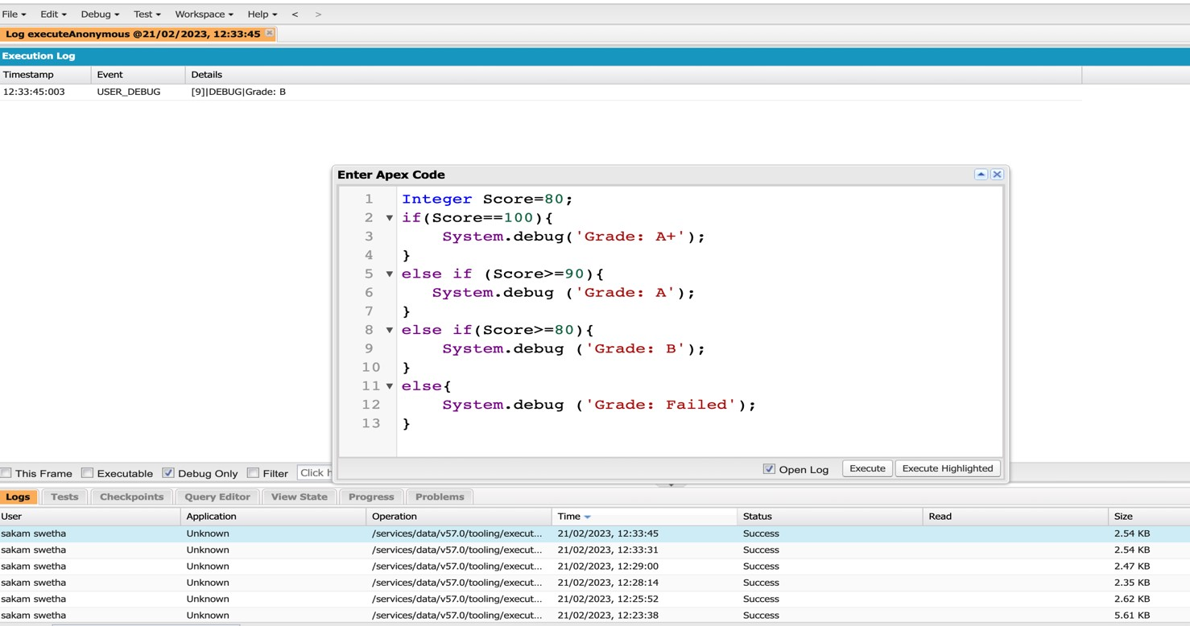
Exercise-06 Write a program and execute to demo the use of “If..else if...else”

Slide 36
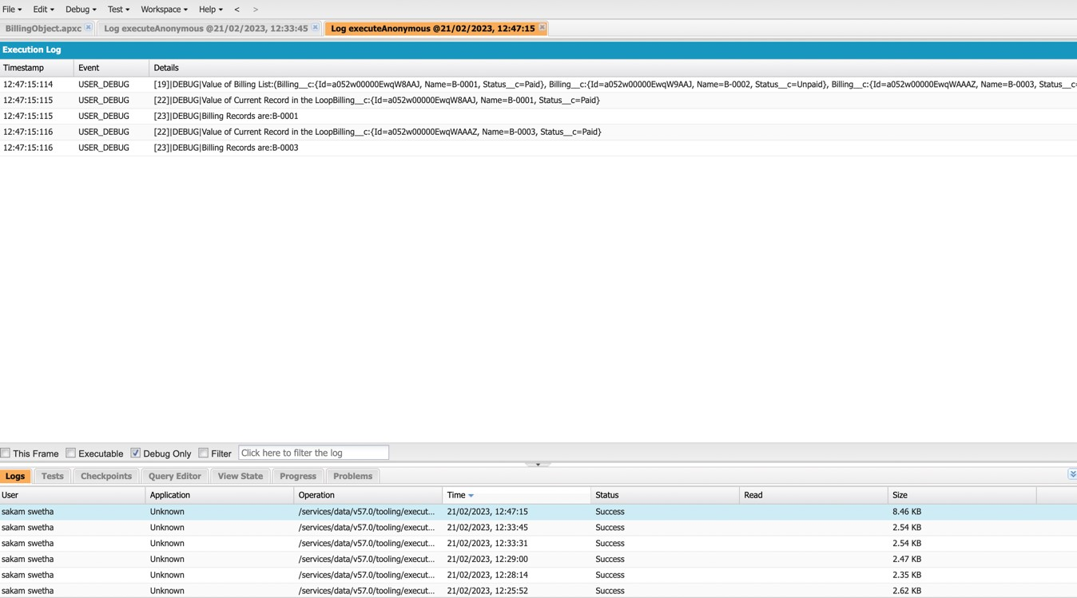
Exercise-07 Write a program to execute and demo the use of “Apex – for Loop”

Slide 37
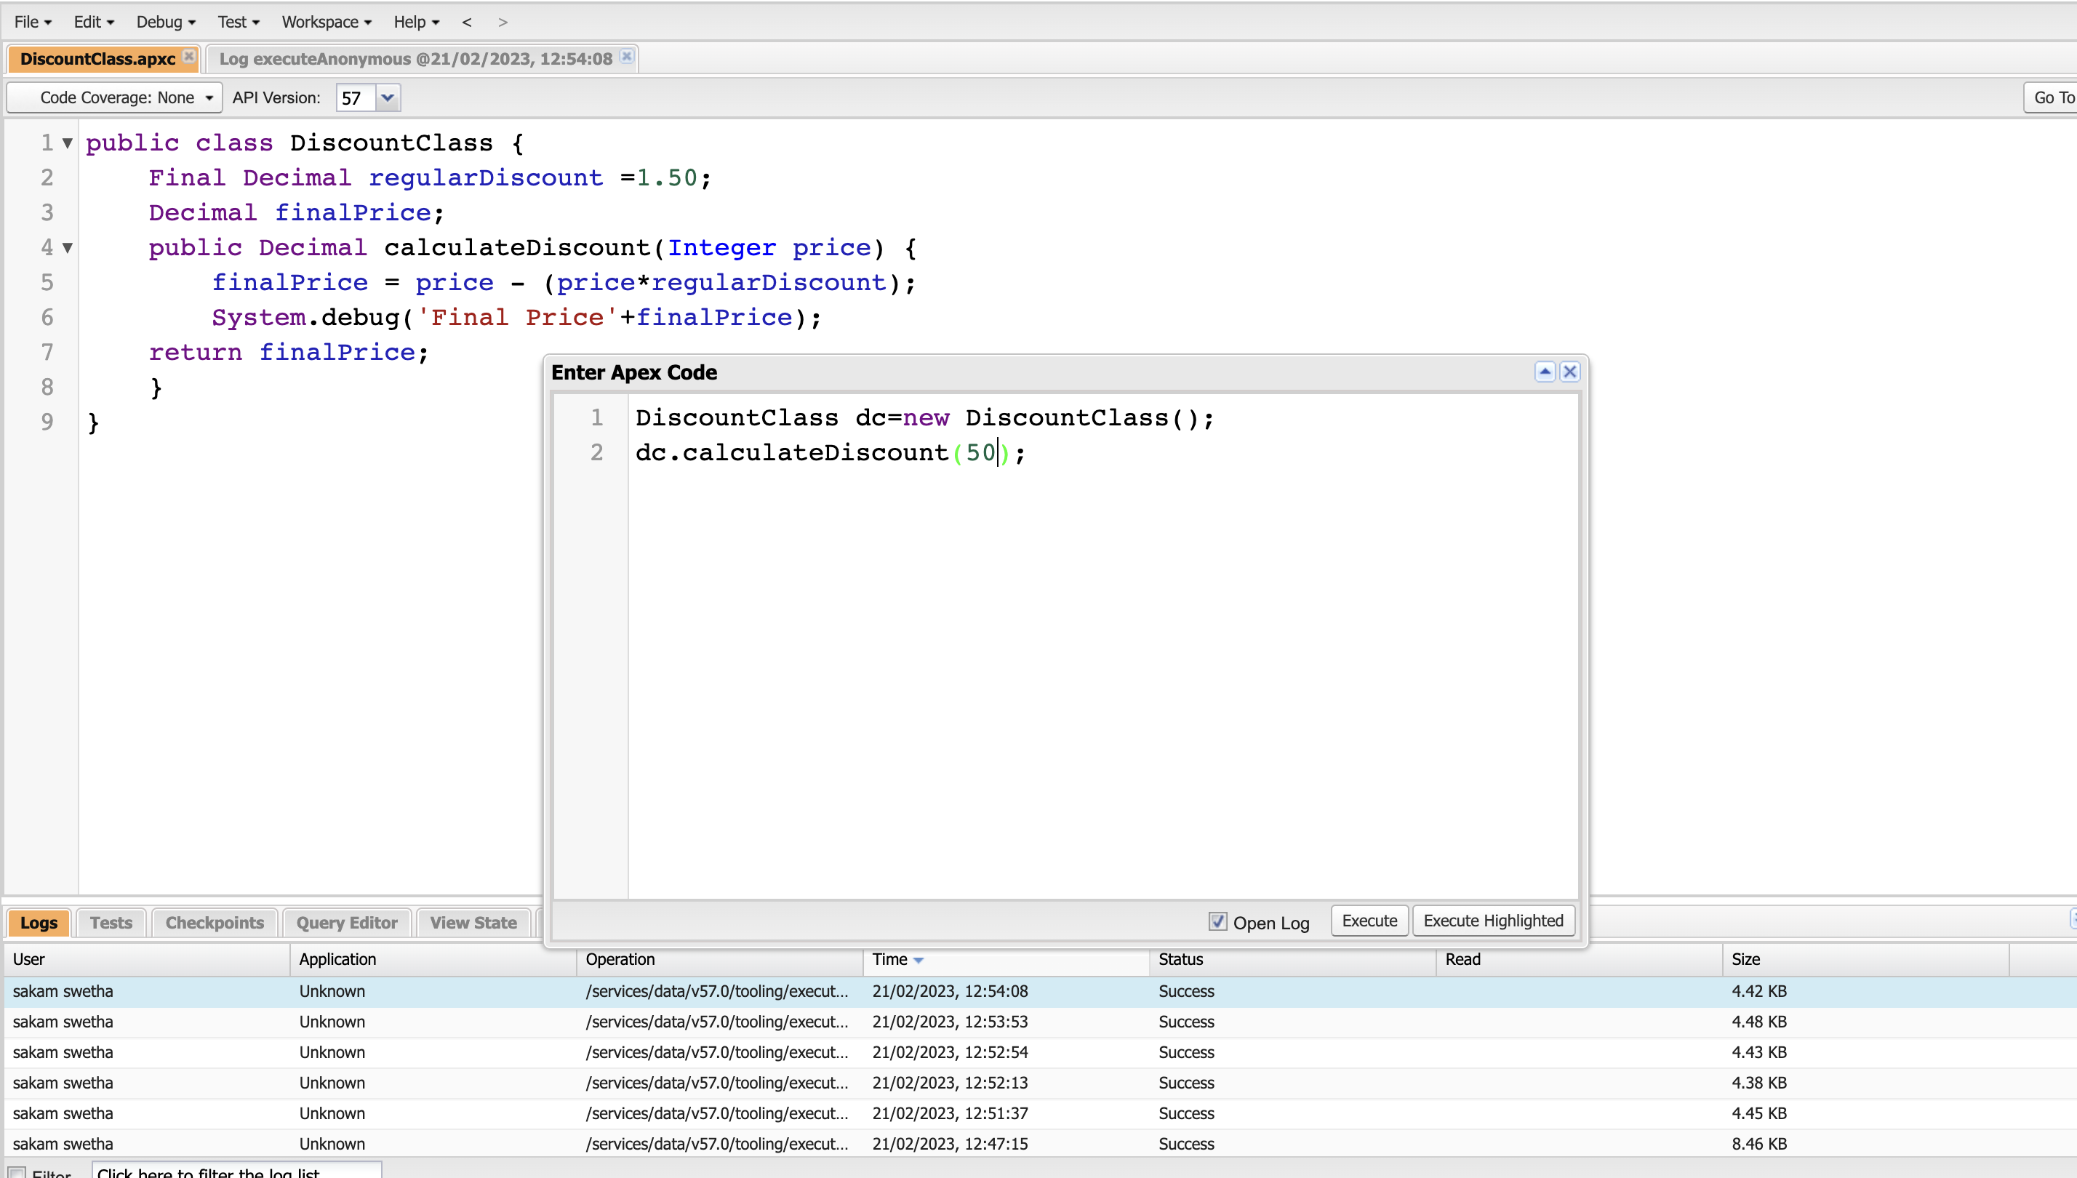
Exercise-08 Write a Class to demo the use of Constants in Apex

Slide 38
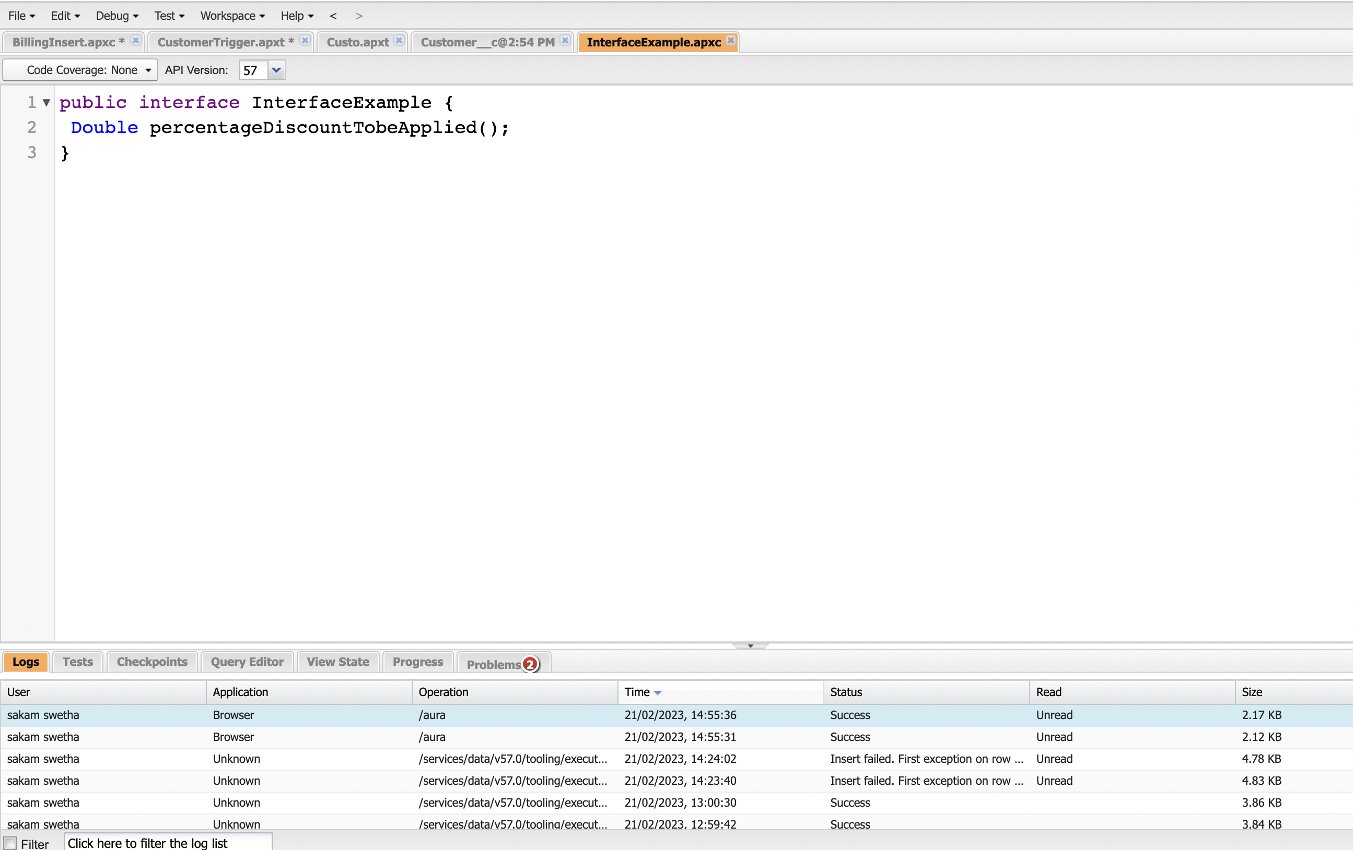
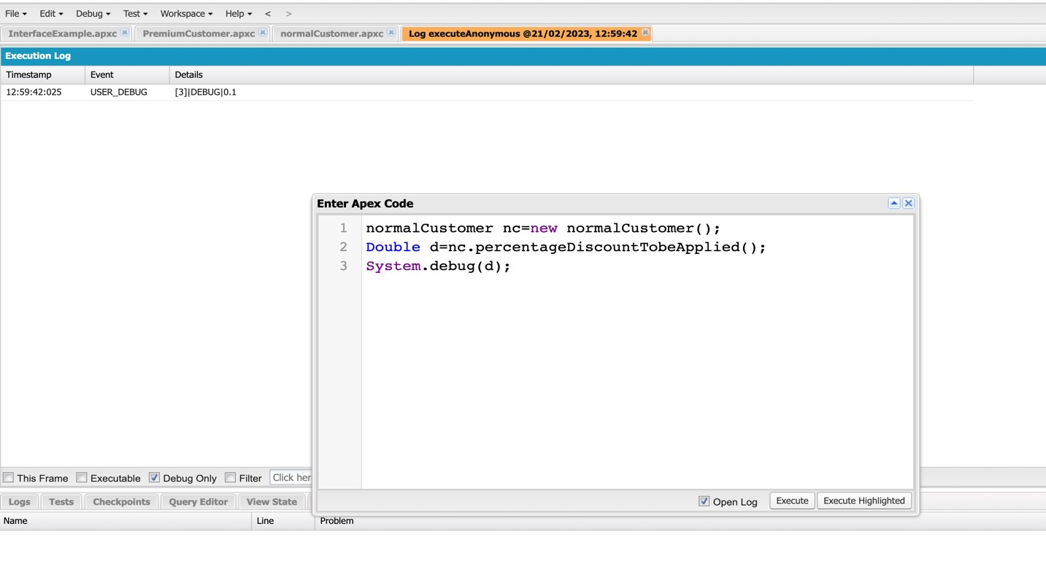
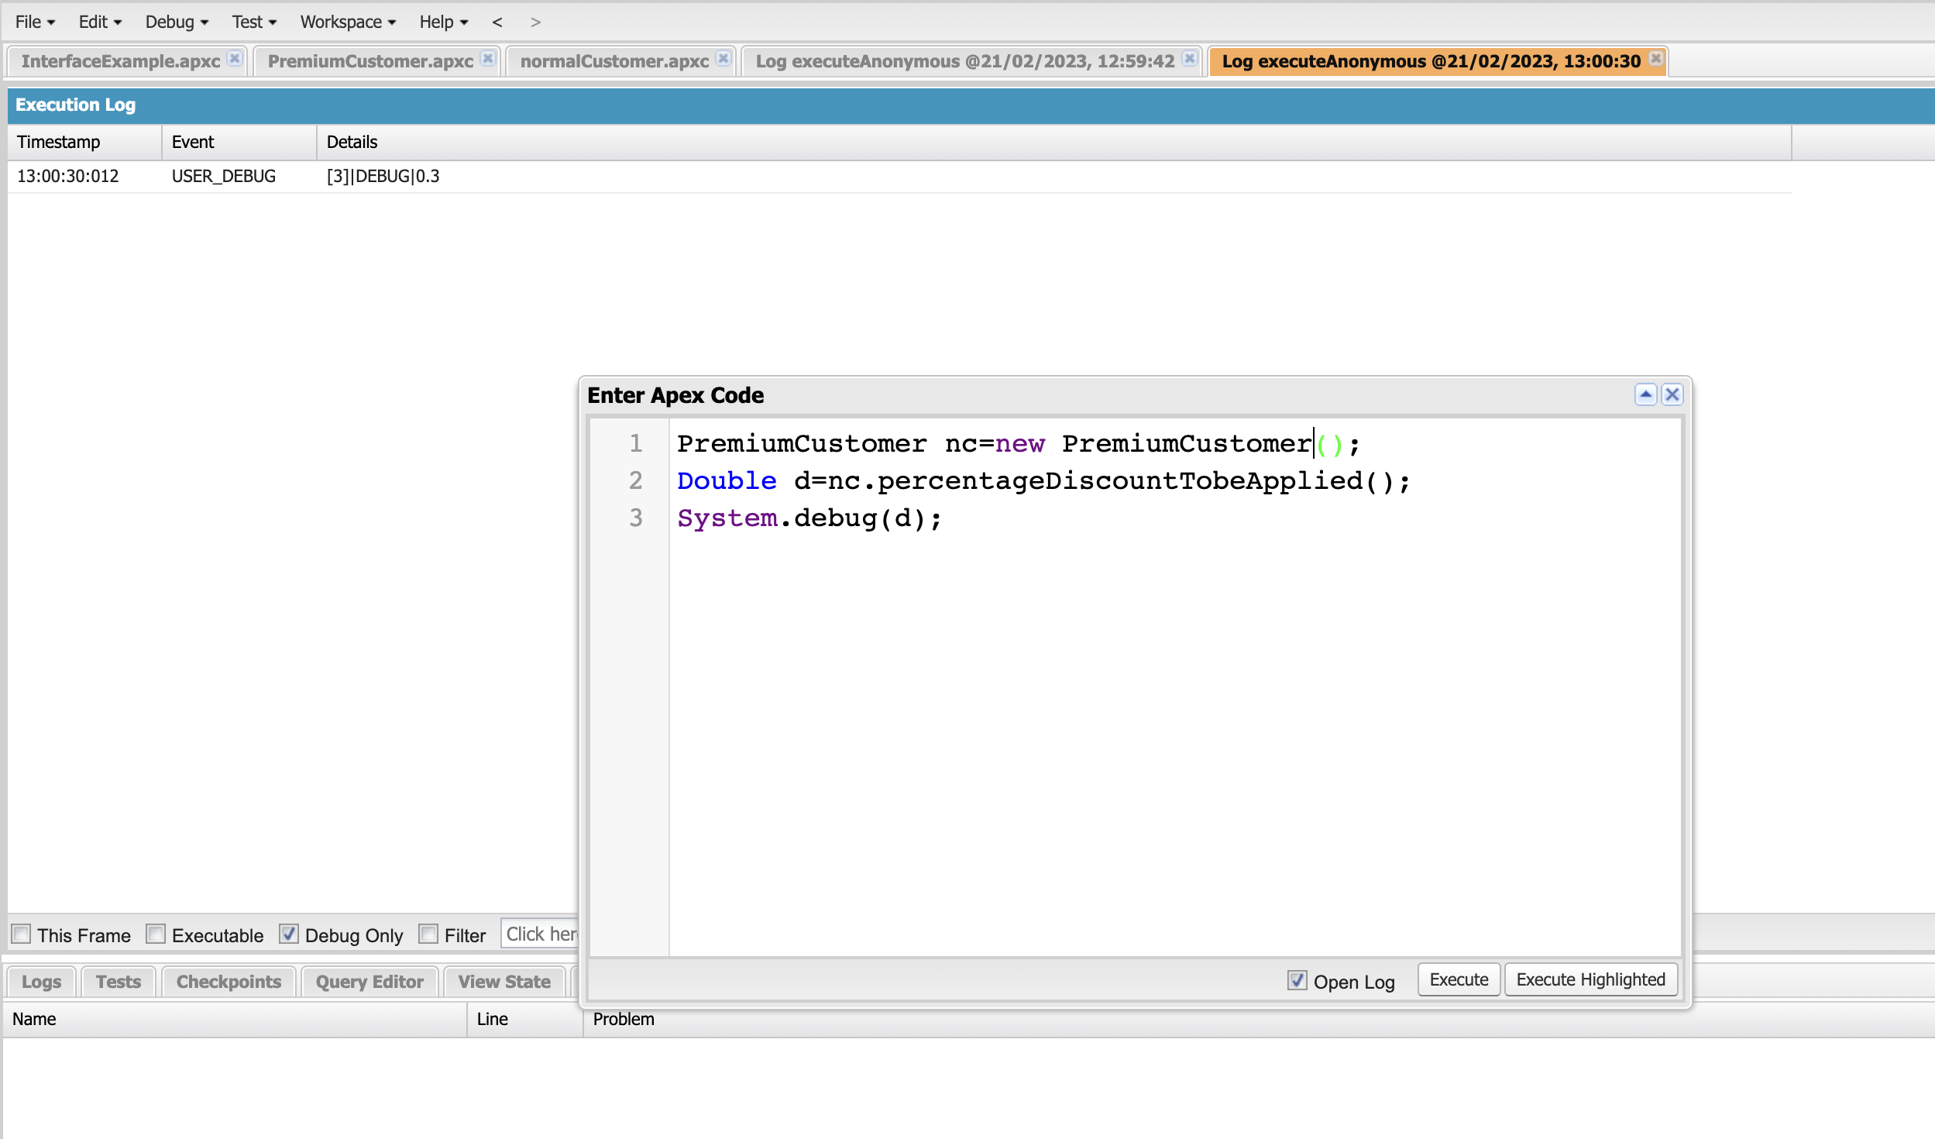
Exercise-09 Write a Class to demo the use of Interface in Apex

Slide 39
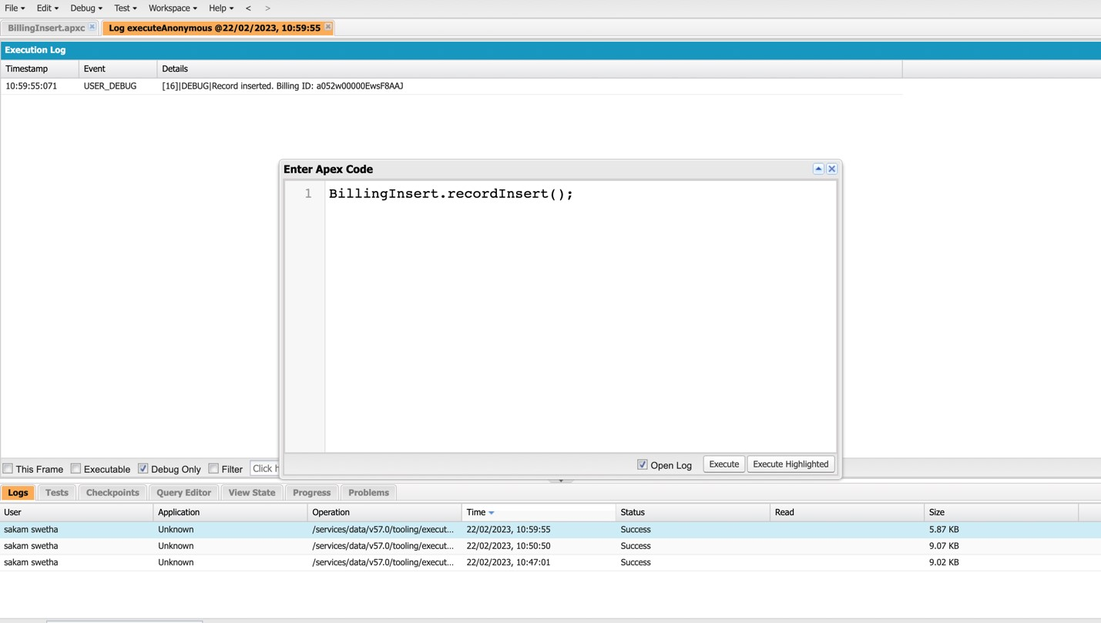
Exercise-10 Demo on DML Insert Operation Using Database methods Insert a Customer Record First using simple DML Statement

Slide 40
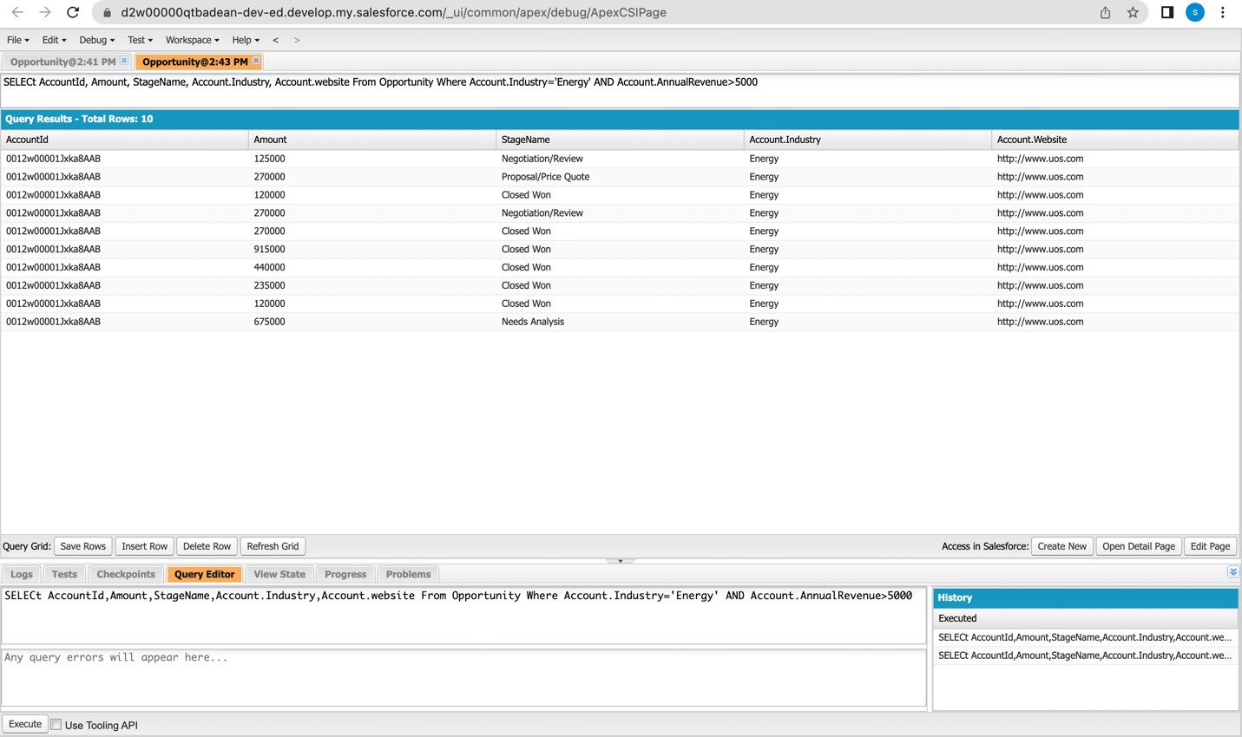
Exercise-11 Write and execute SOQL queries from Developer Console

Slide 41
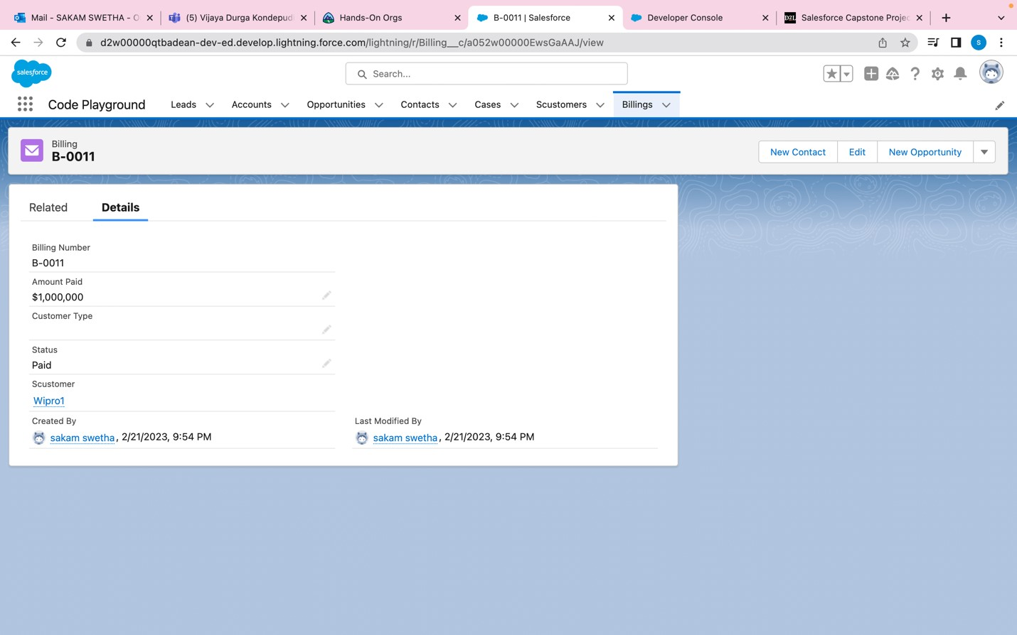
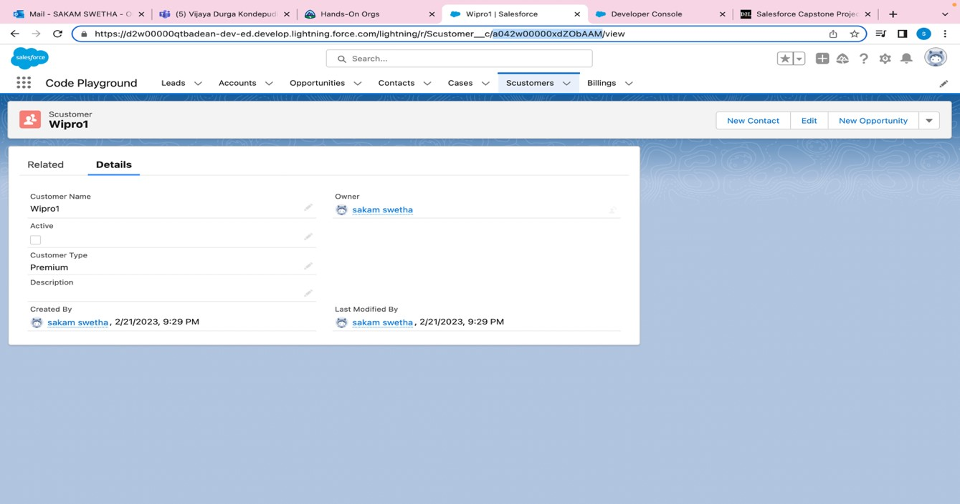
Exercise-12 Write an Apex Trigger, Name = CustomerTrigger.

Slide 42
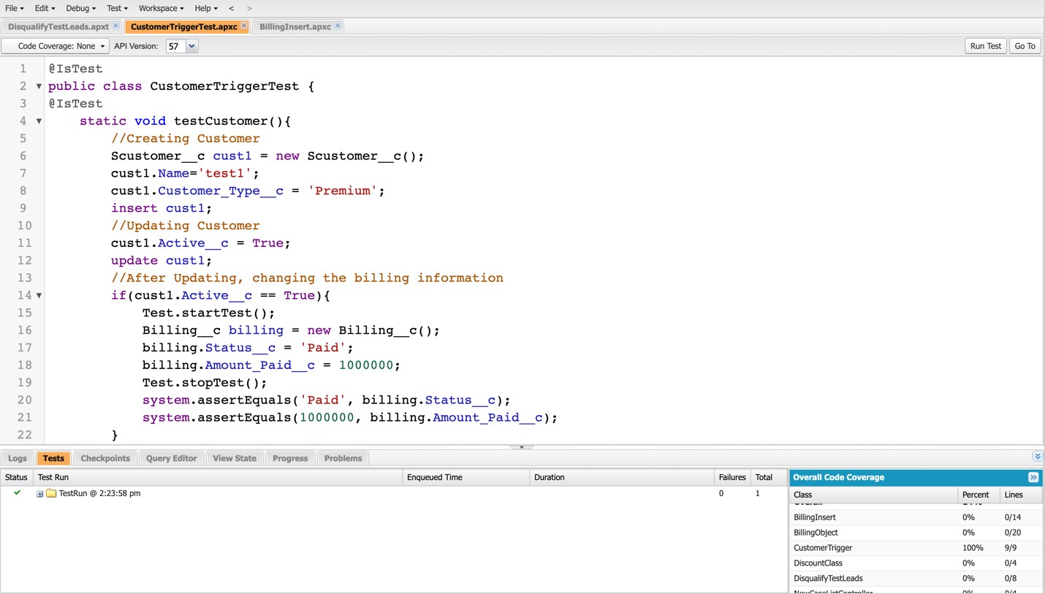
Exercise-13 Write a Test Class for CustomerTrigger.

Slide 43
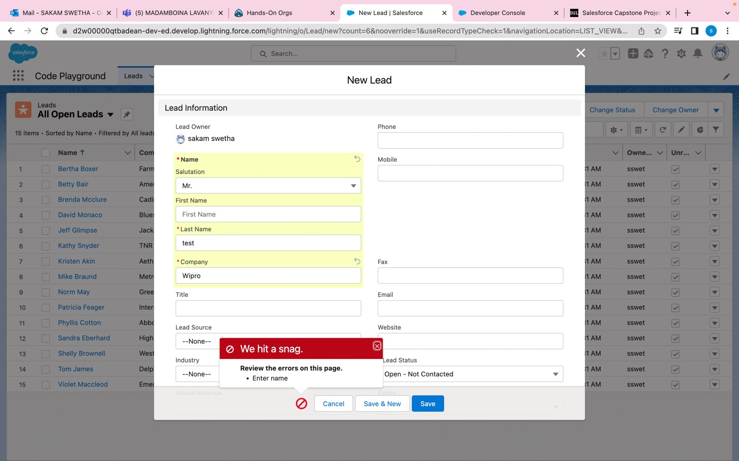
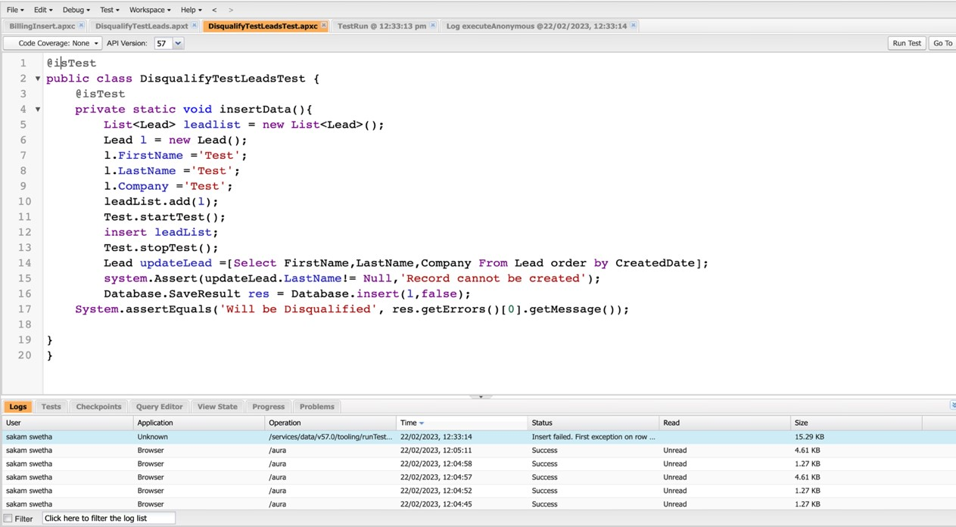
Exercise -14
ApexTrigger ,Name = DisqualifytestLeads
Exercise -15
Write a test class for Disqualifytestleads

Slide 44
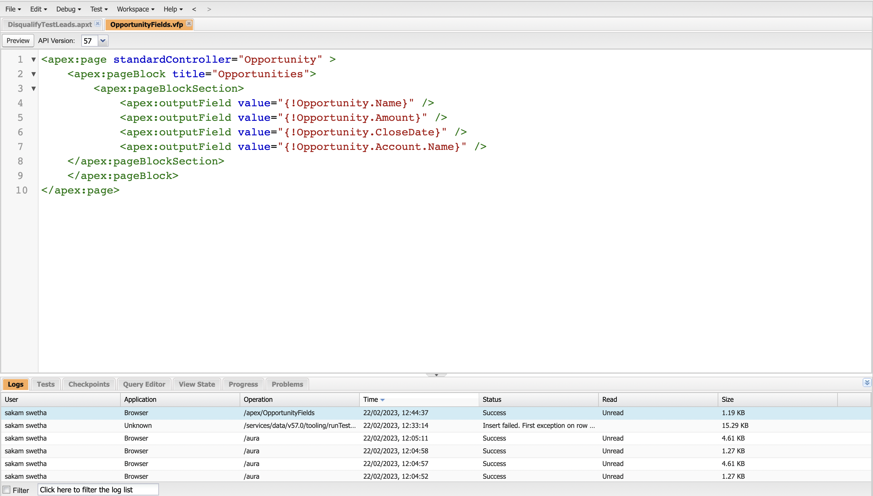

Exercise-16 Create a Visualforce page which displays Opportunity fields as output fields.

Slide 45


Exercise-17 Create a Visualforce page which shows a list of Accounts linked to their record pages

Slide 46



Exercise-18 Create a Visualforce page that uses a custom controller to display a list of cases with the status of 'New'. The page must be named NewCaseList.

Slide 47
Thank
You

